Slide 1
Hello!
Notes:
Hello. It’s lovely to be here

Slide 2


Slide 3


Slide 4
The skills you (actually) need to deliver services
that work*

Slide 5
Writing business cases
Leading stakeholders
Measuring services
Prototyping services
Building service literacy

Slide 6
Bad services

Slide 7
Bad services
Why they happen

Slide 8
Bad services
Why they happen
How we get out of this mess

Slide 9

It’s 11.53pm

Slide 10
It’s 11.53pm
Sarah is in Dalston

Slide 11
It’s 11.53pm
Sarah is in Dalston
She’s just got out an Uber to go to Karaoke Hole

Slide 12
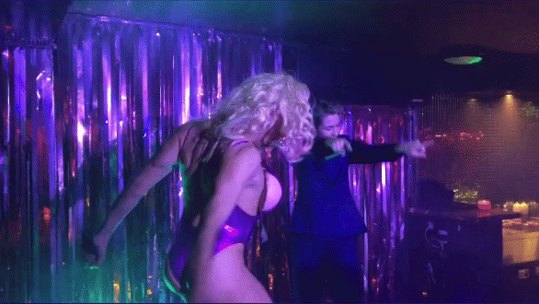

Slide 13

She reaches into her pocket but there’s no phone

Slide 14
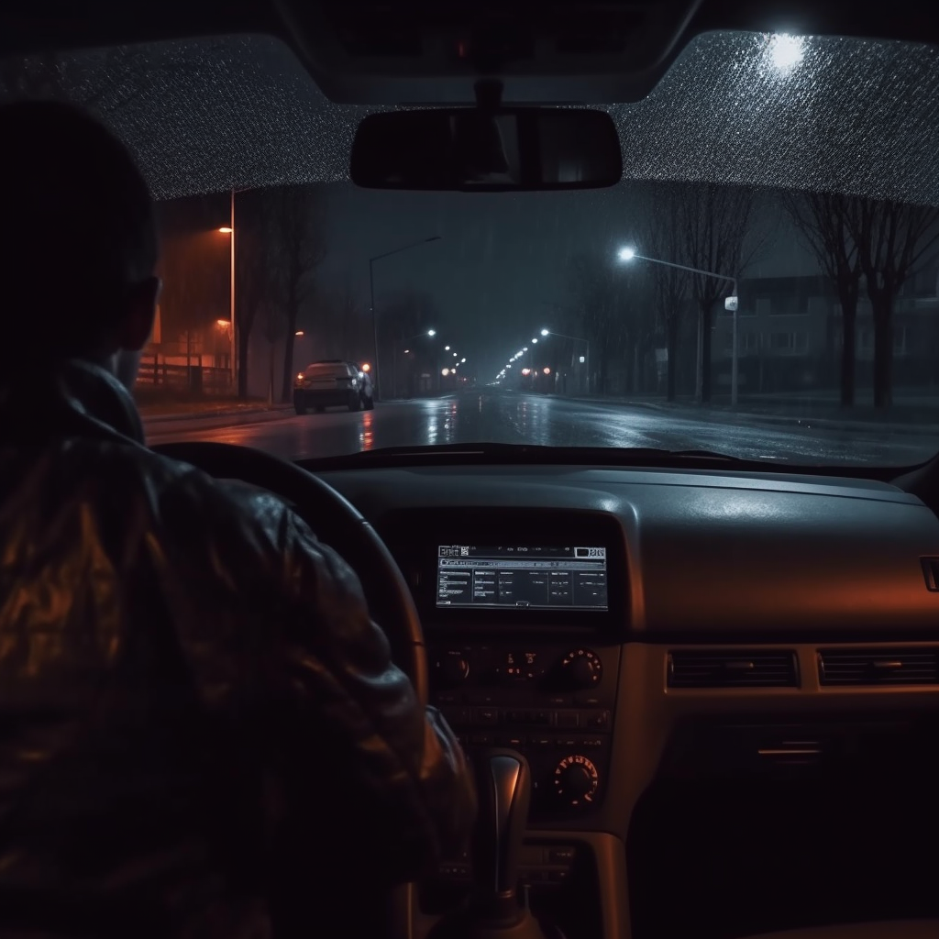
She’s left it in the Uber

Slide 15
“I’m sorry we can’t contact the driver for you without you logging into our app and going through the lost an item process”

Slide 16
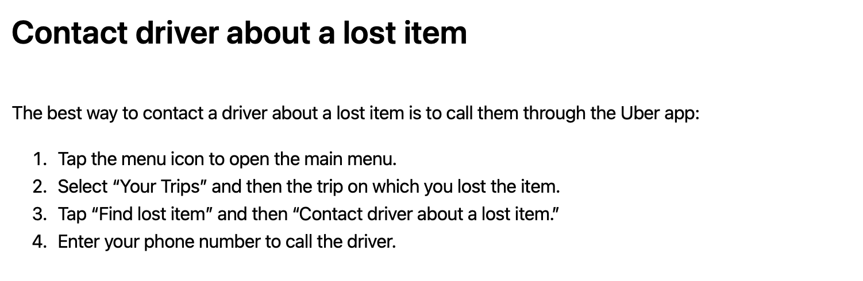

Slide 18


Slide 19
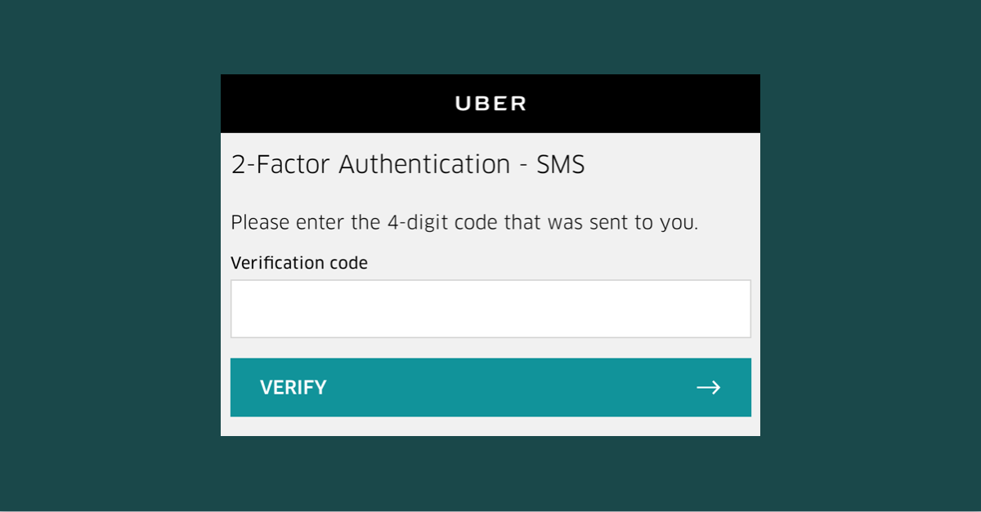

Slide 20
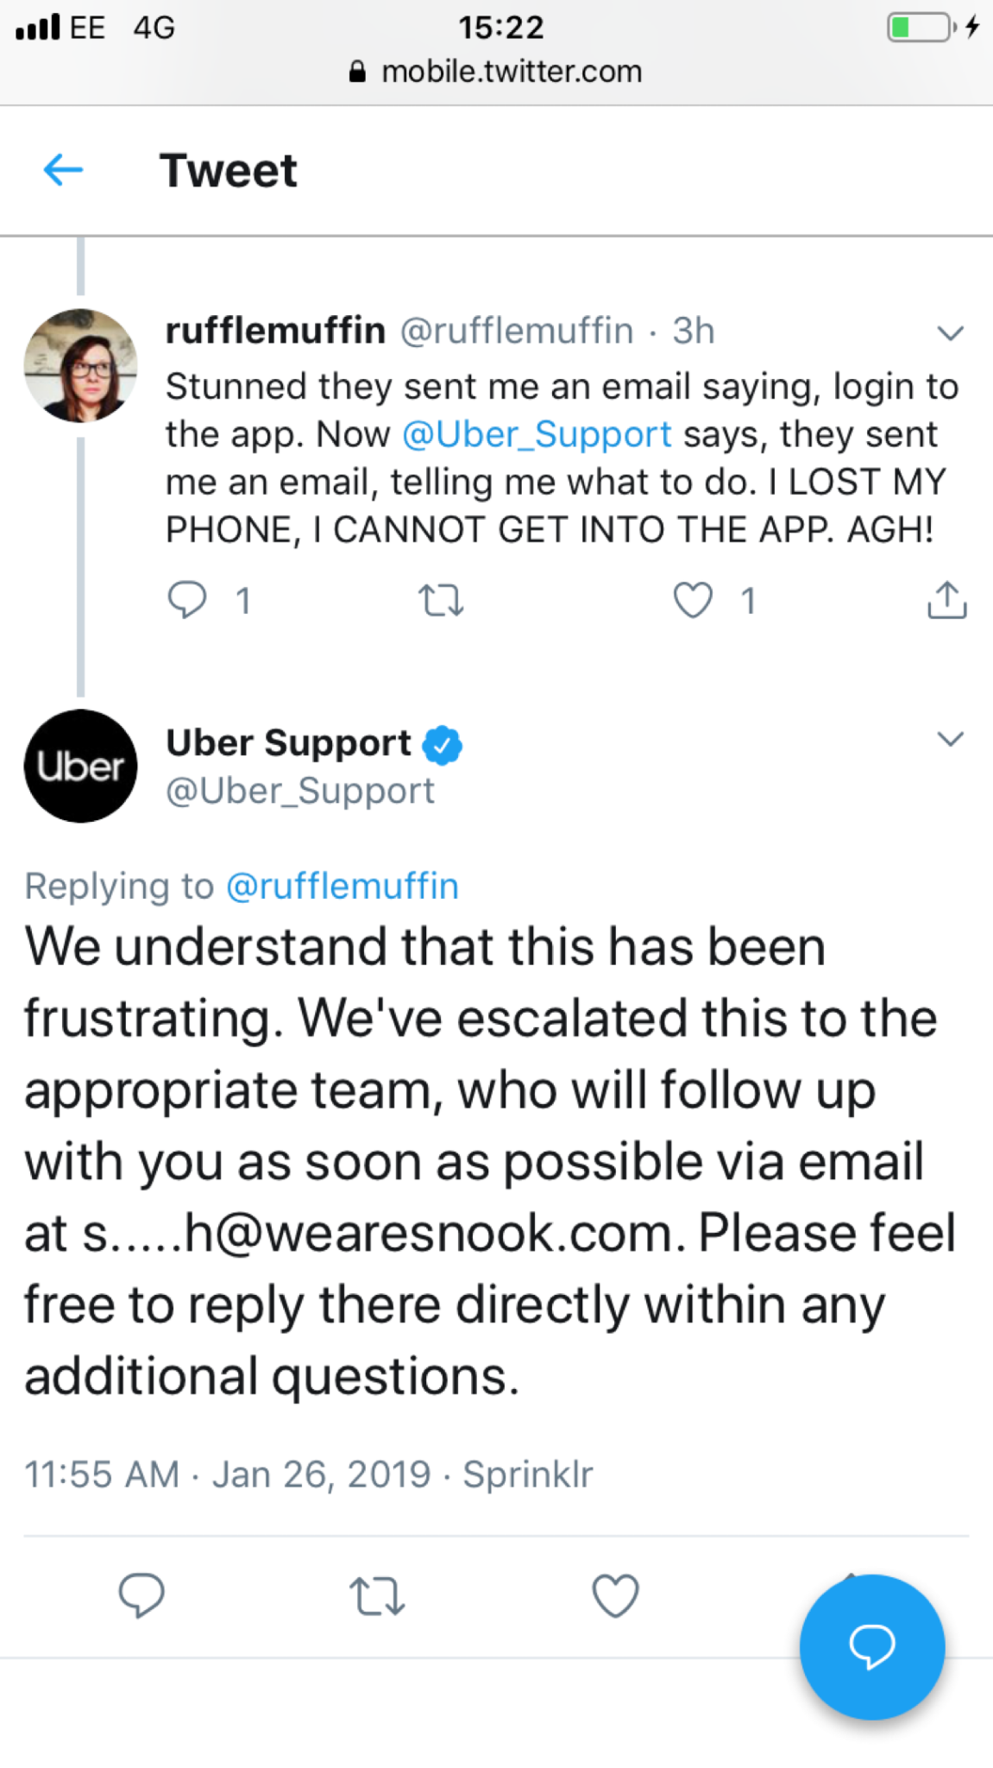

Slide 21
What do we do when we reach a dead end?!

Slide 22
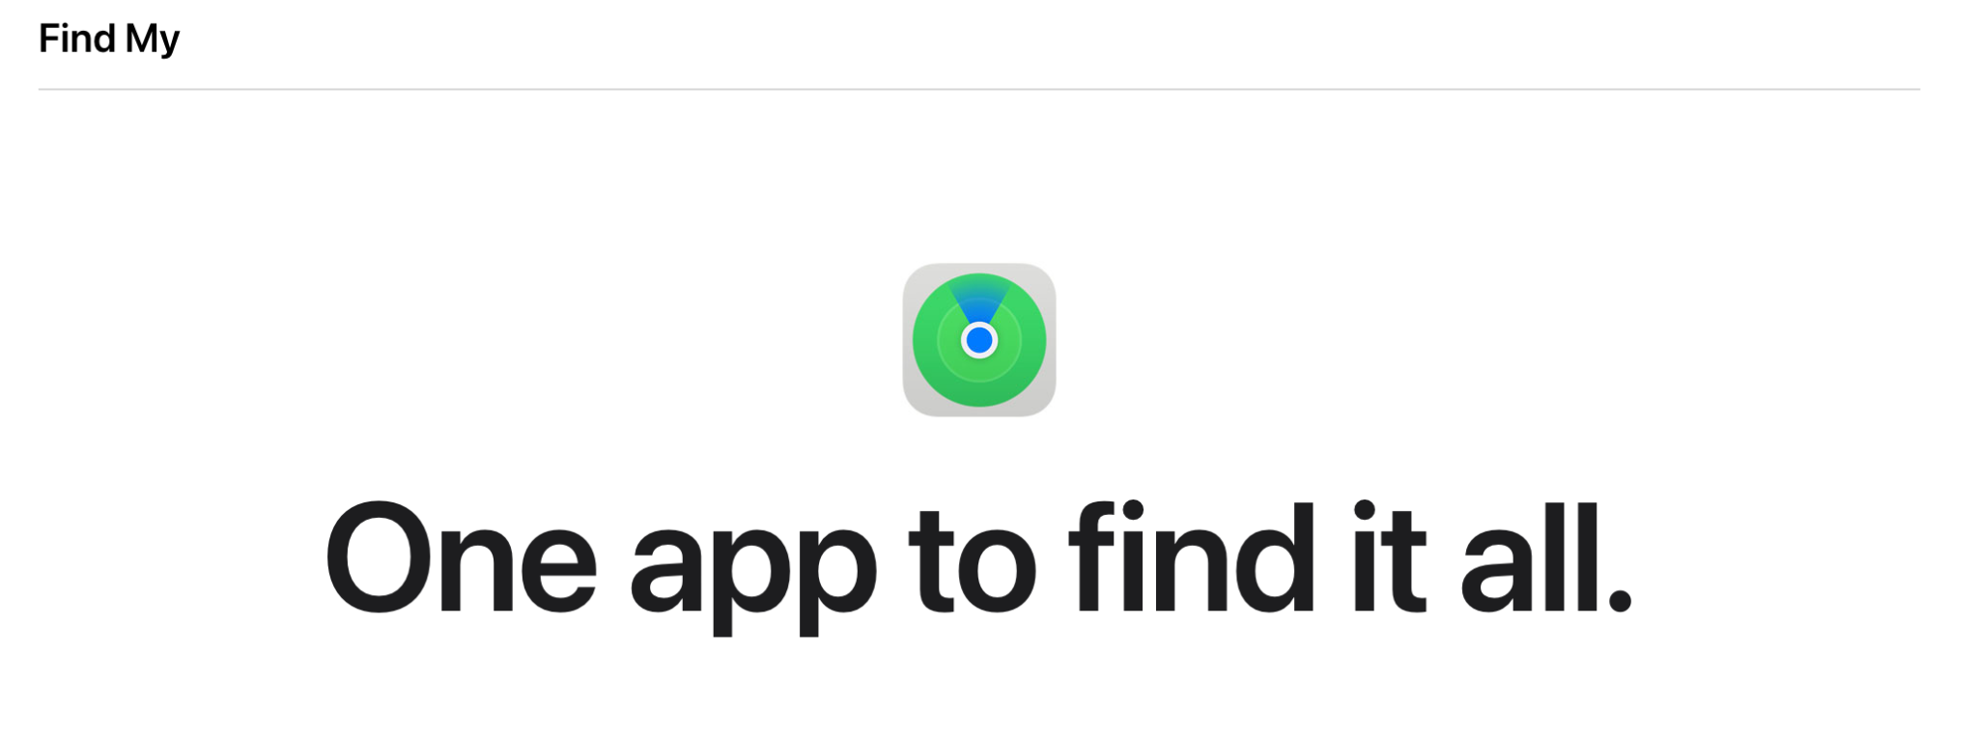

Slide 23
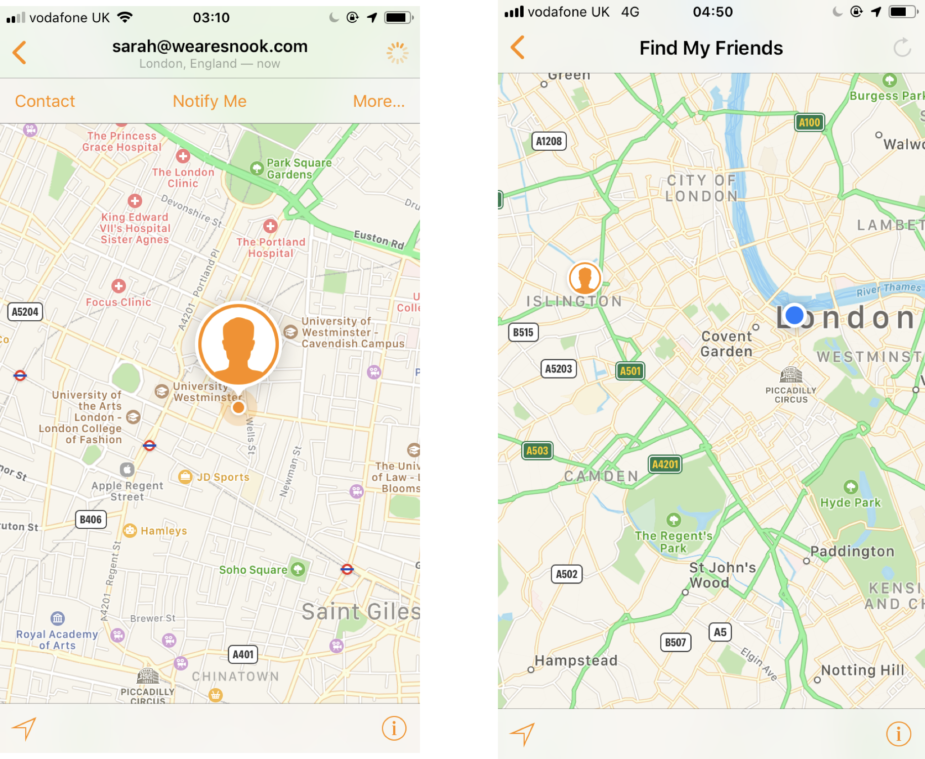

Slide 24
6 hours later….

Slide 25
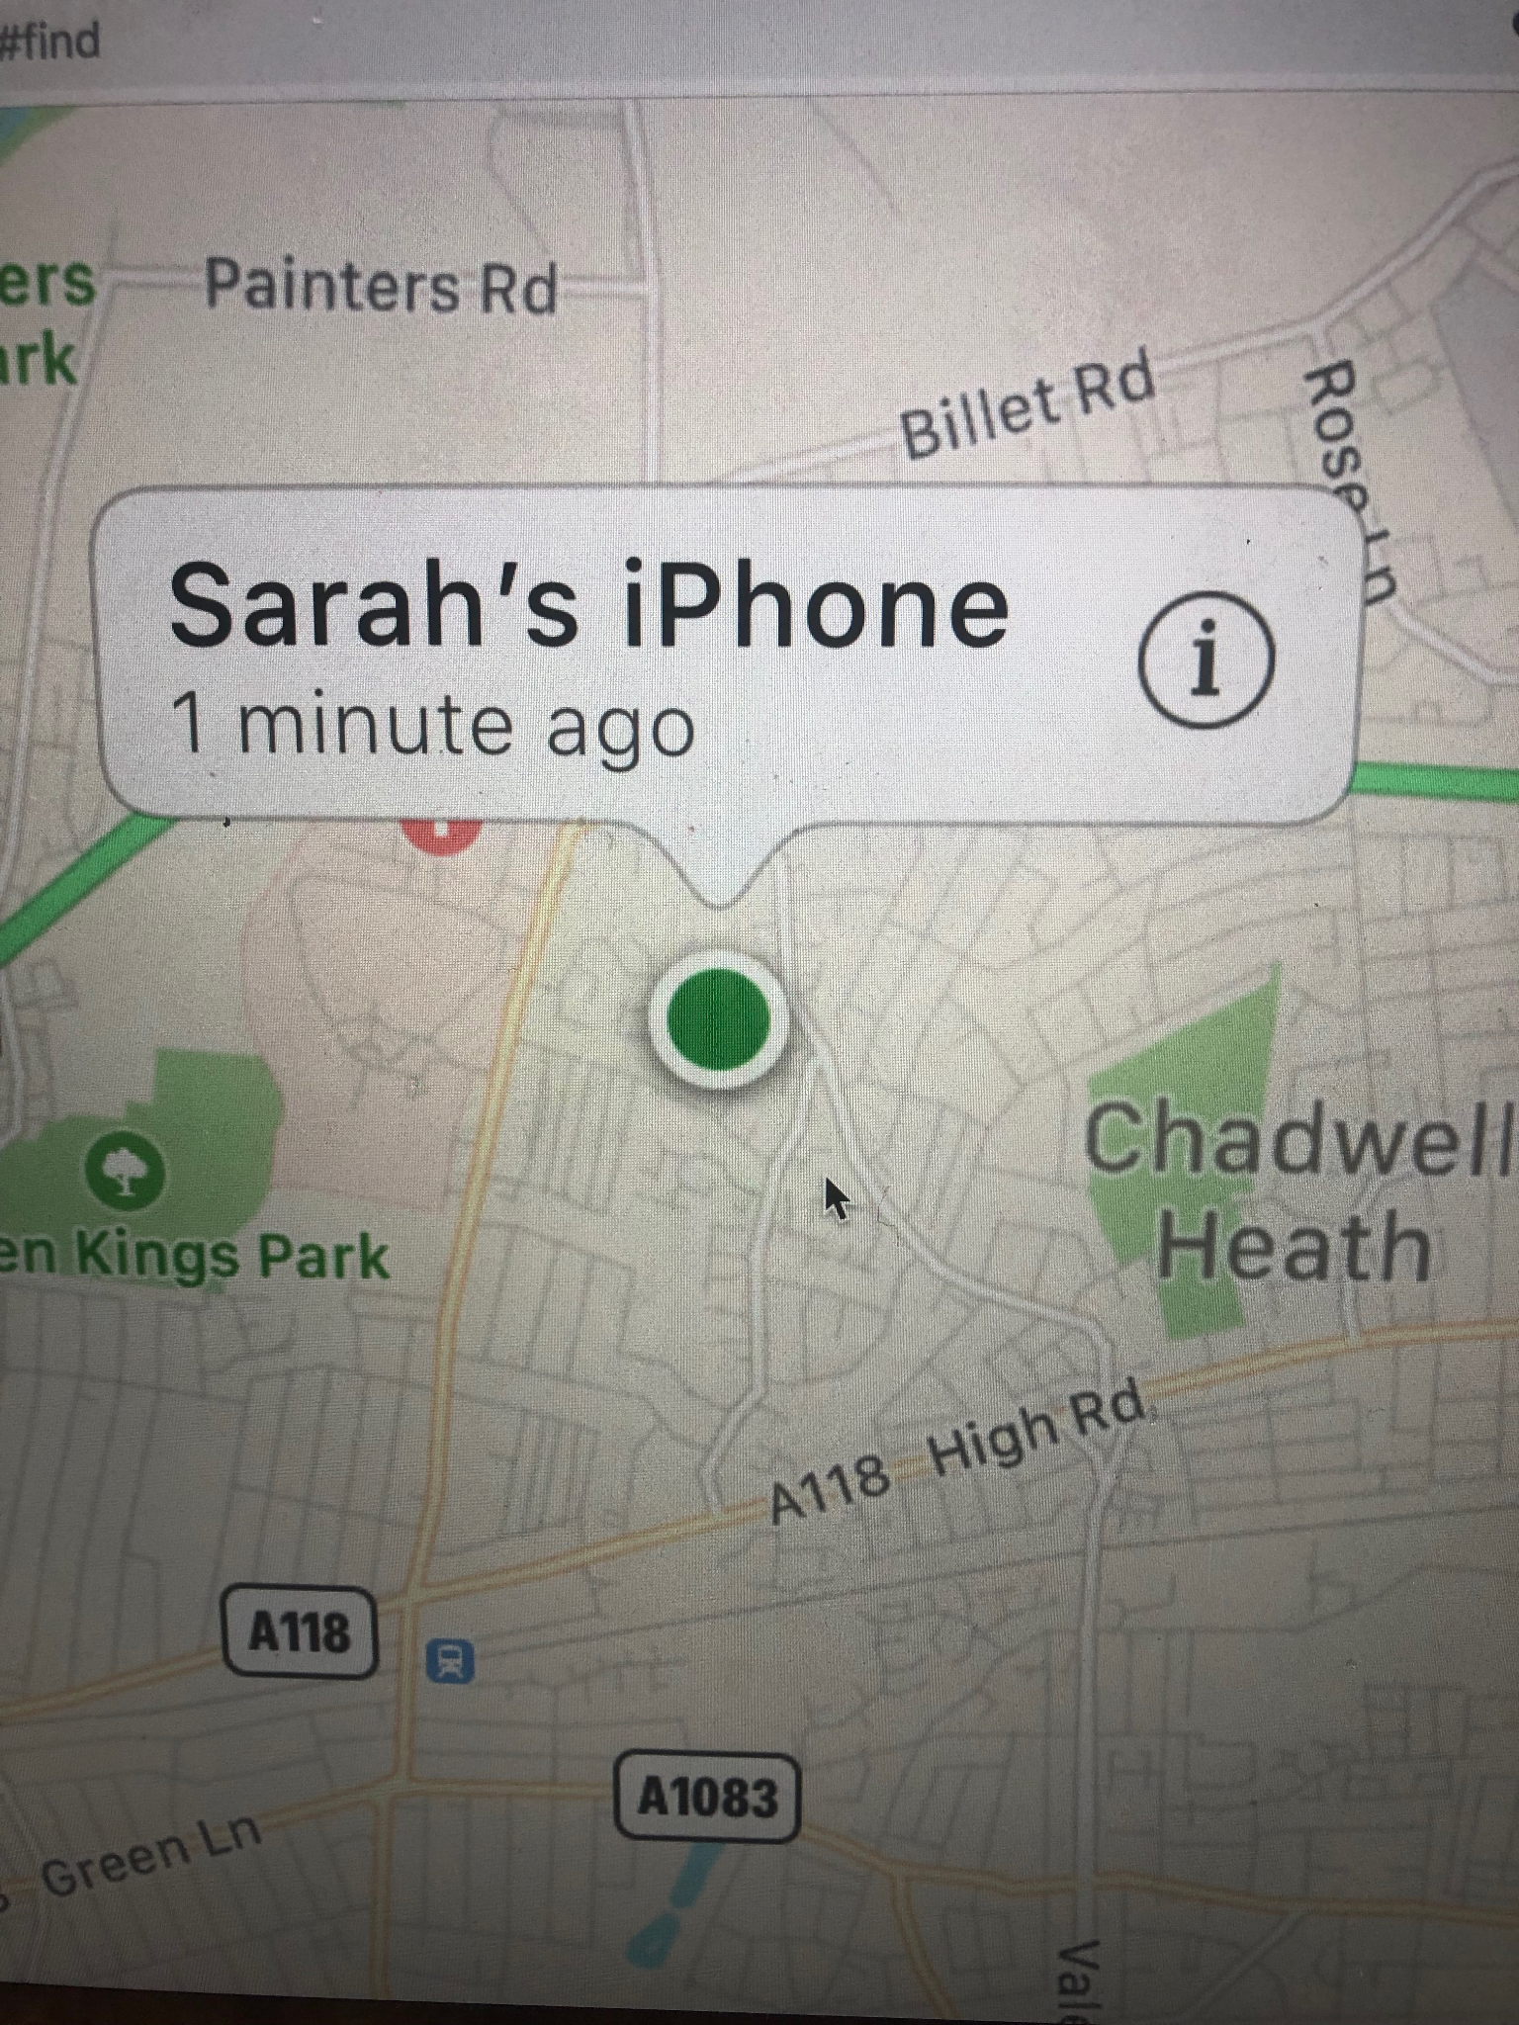

Slide 26
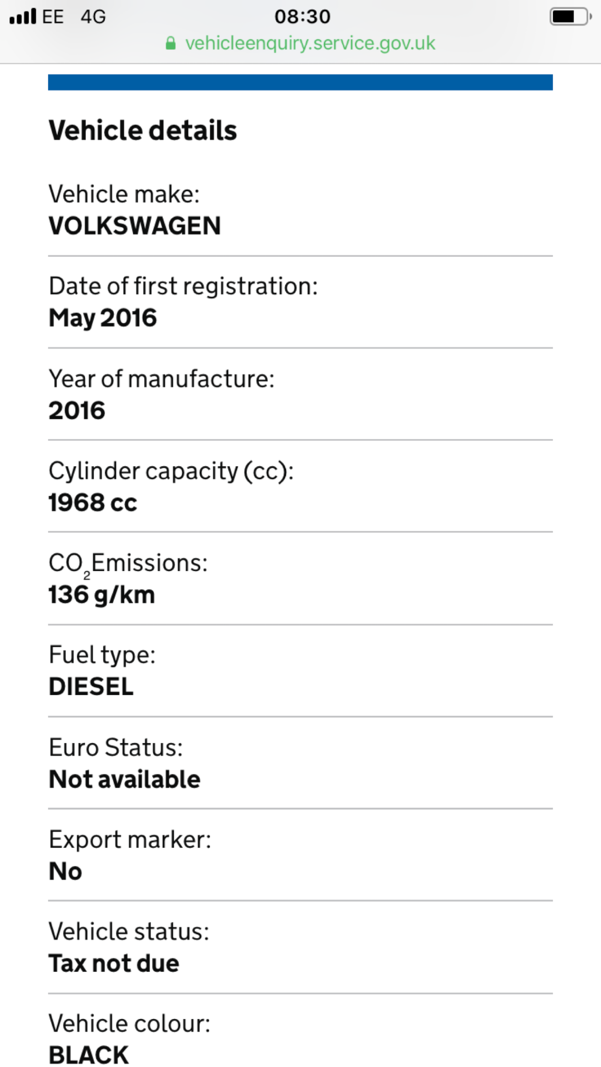

Slide 27
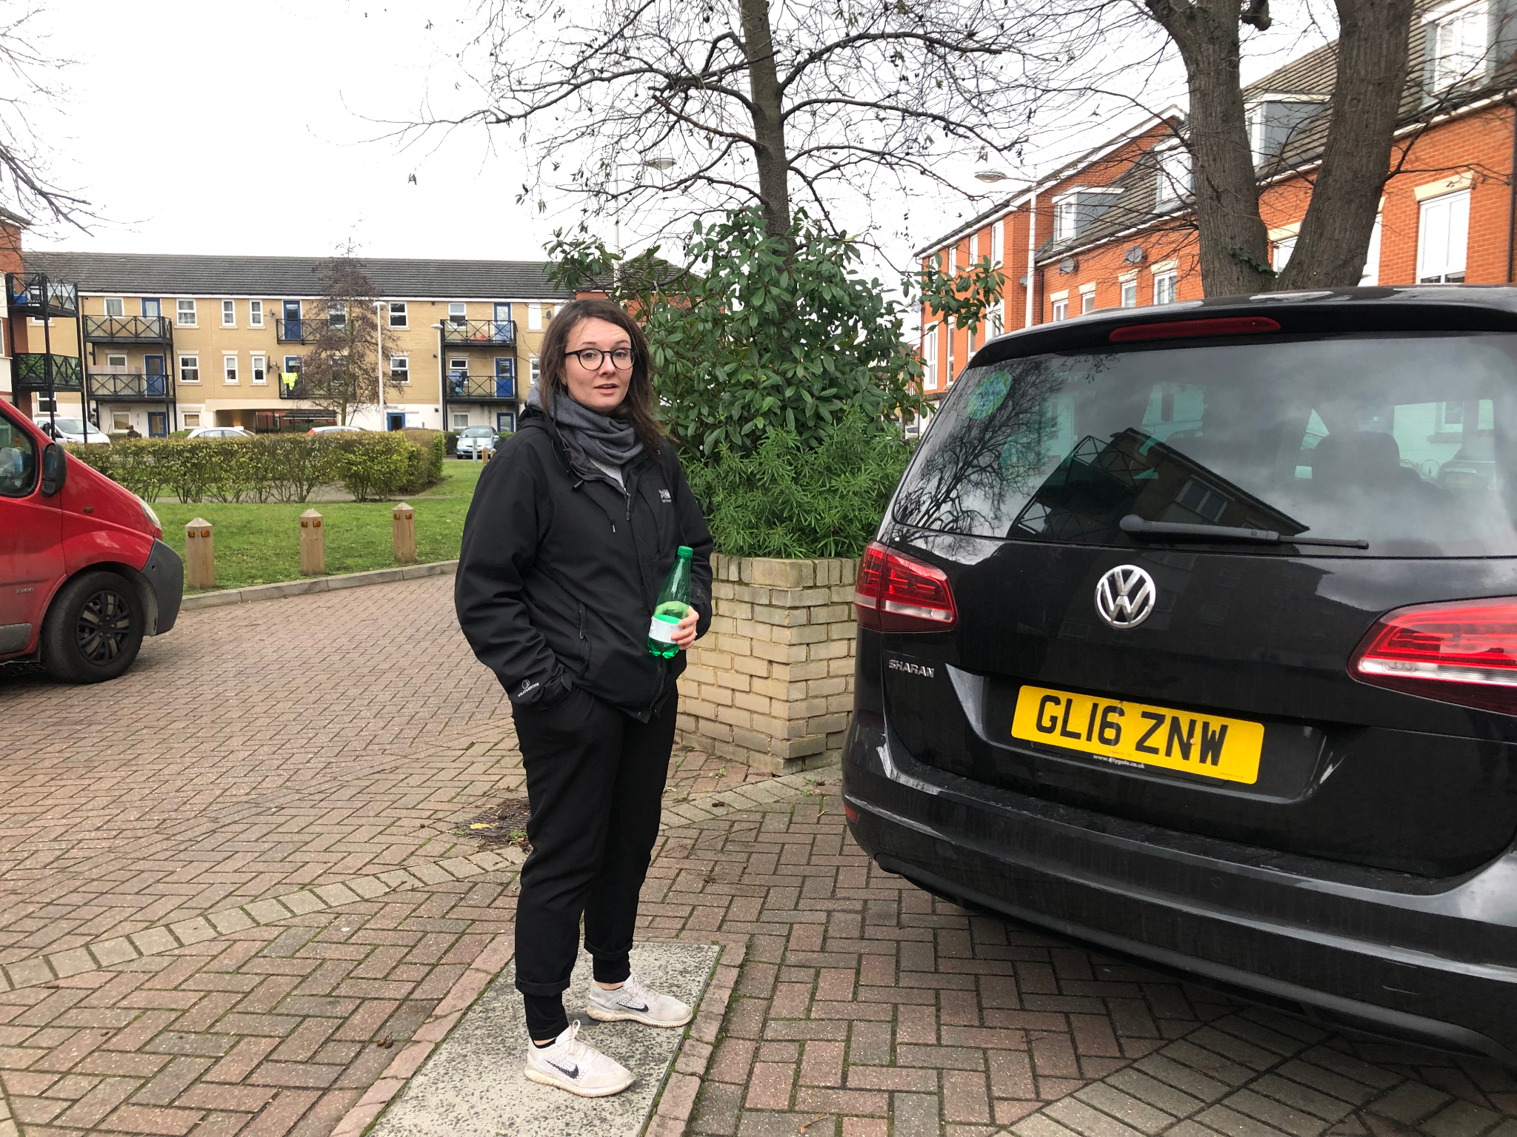

Slide 28
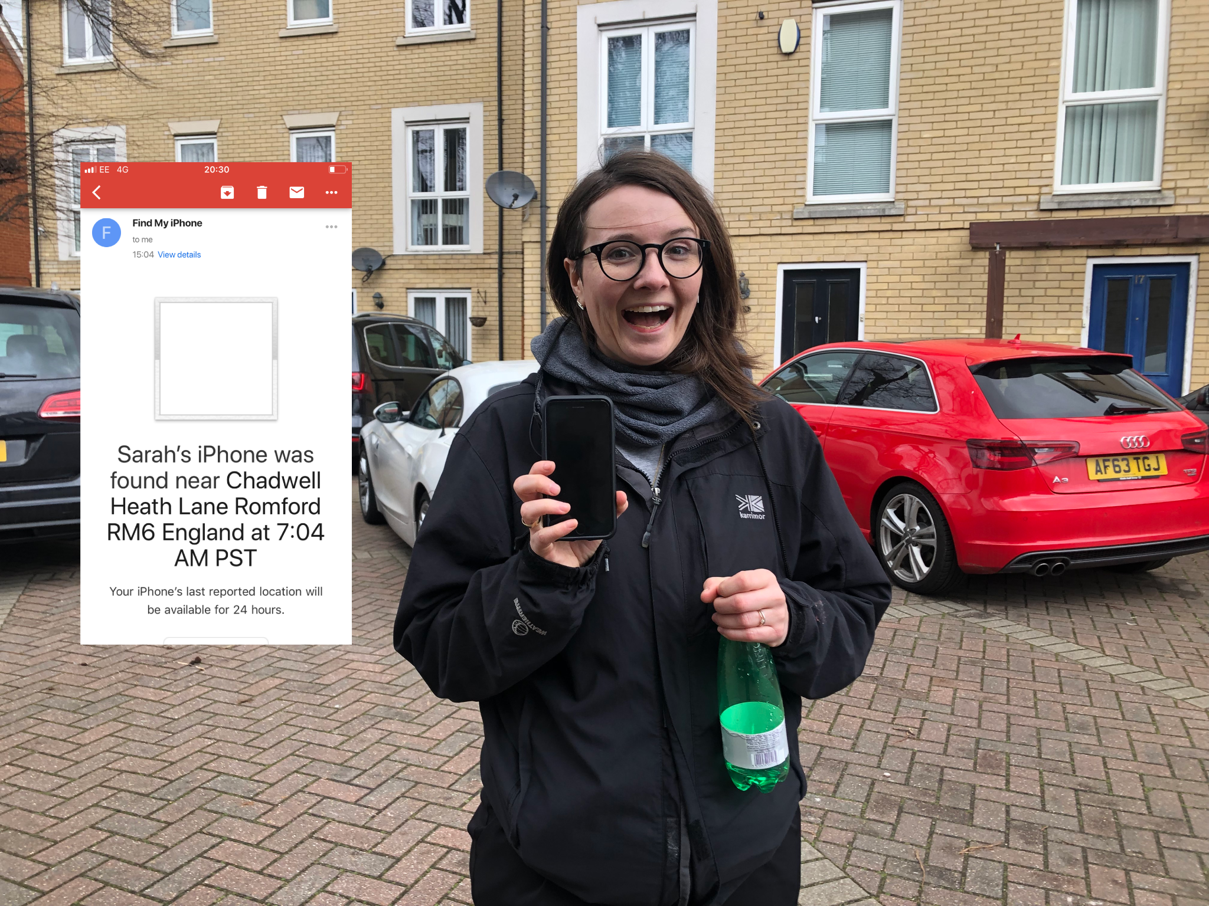

Slide 29
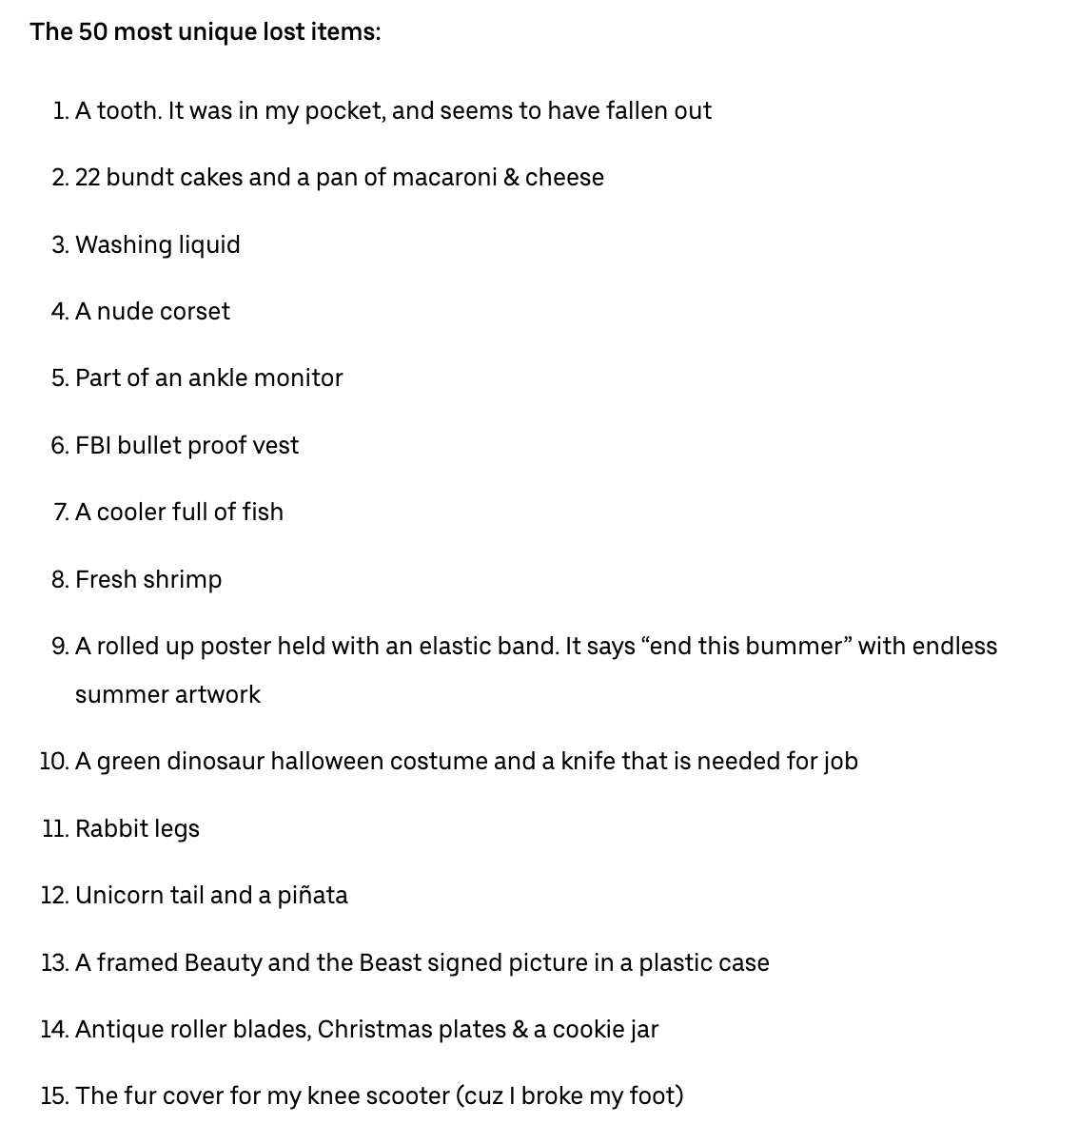
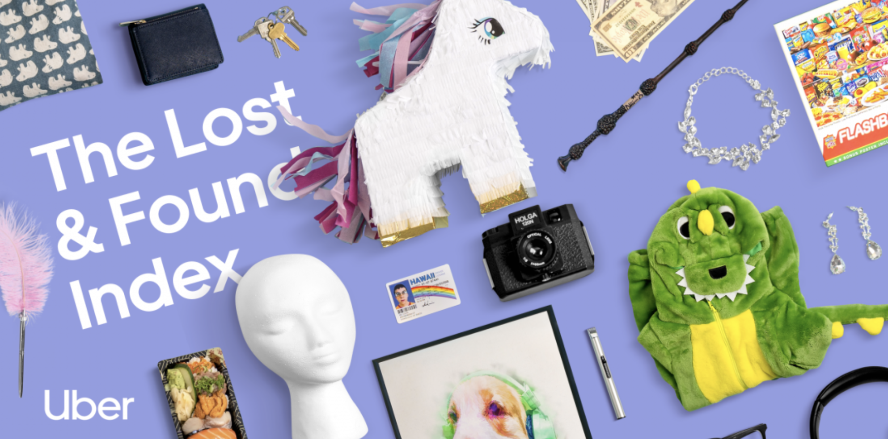

Slide 30
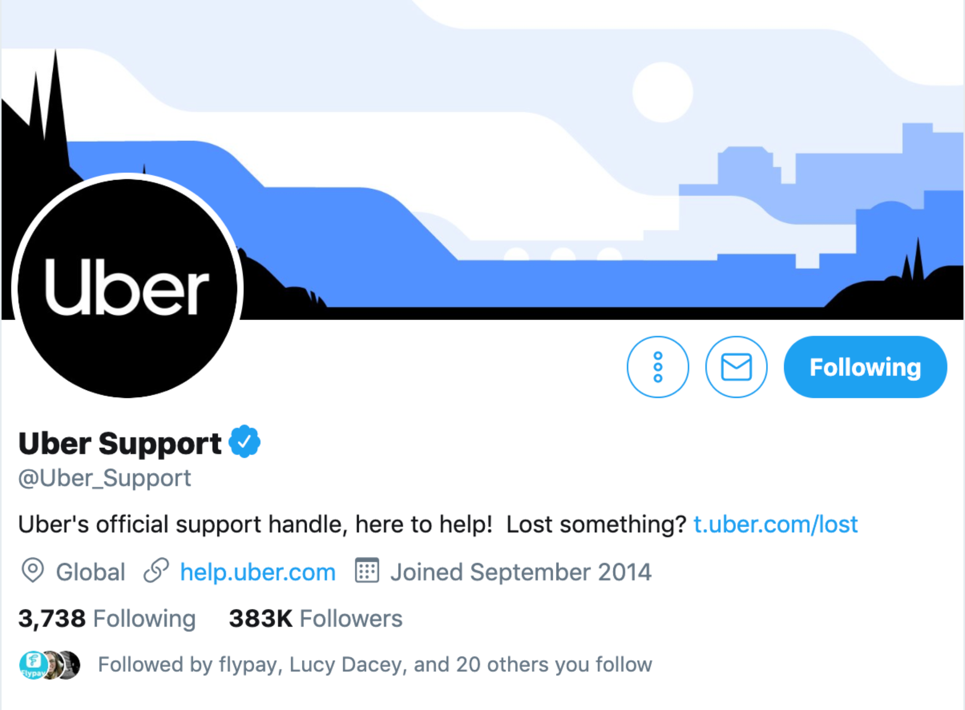

Slide 31
Is this the utopia
we all imagined?!

Slide 32
Bad services cost us time

Slide 33
Bad services cost us money

Slide 34
Bad services put us at risk

Slide 35
Bad services ruin our lives

Slide 36
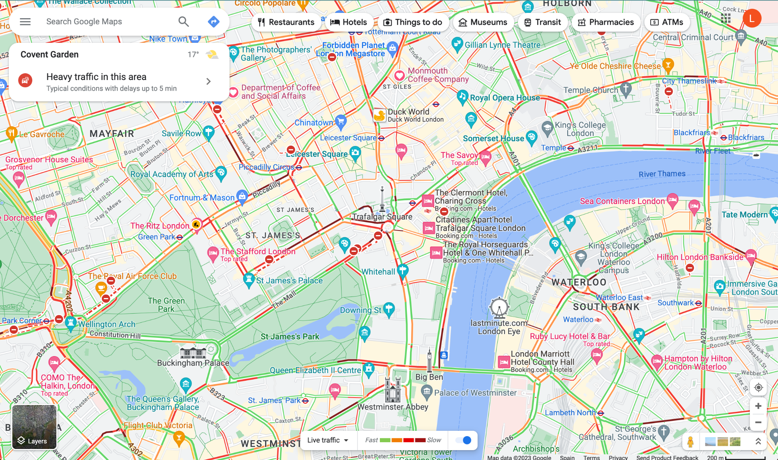

Slide 37
57% taxis

Slide 38
57% taxis
25% delivery vans

Slide 39
57% taxis
25% delivery vans
£20 per m2

Slide 40
We took part in this…

Slide 41
“The Sharing Economy”

Slide 42
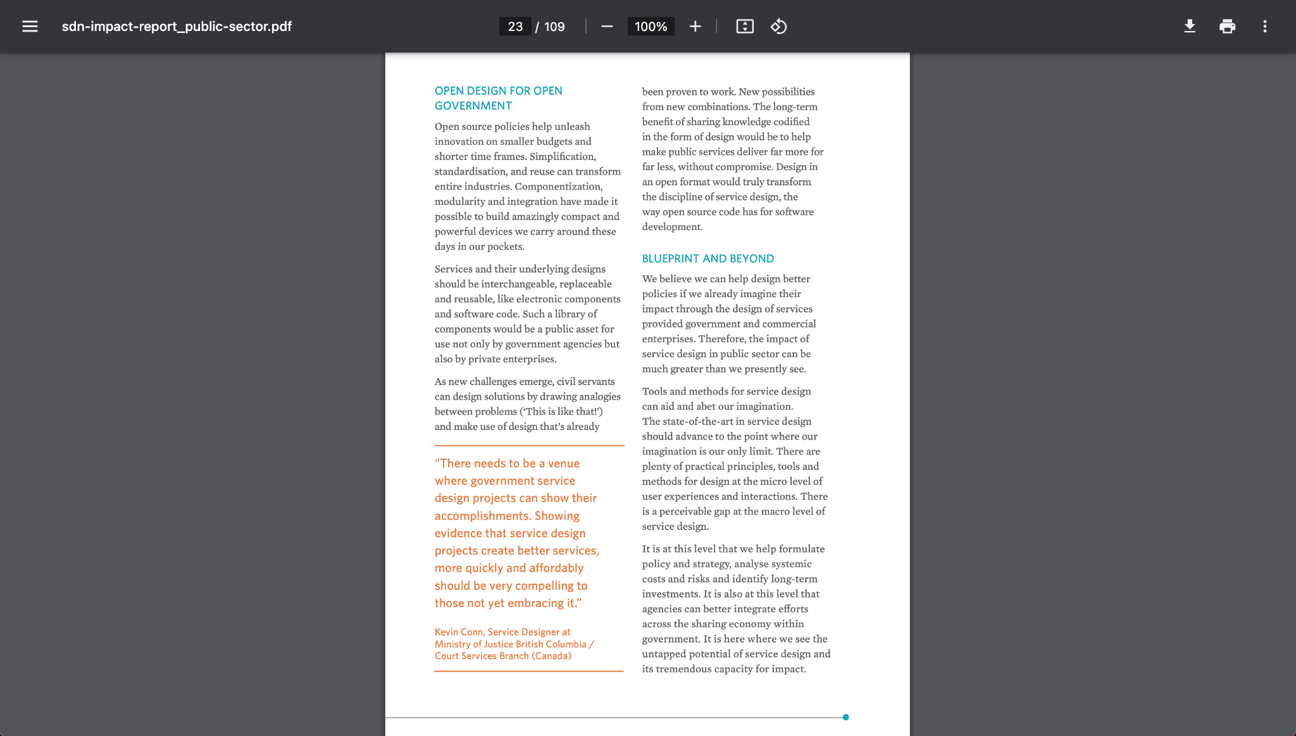
We took part in this…

Slide 43
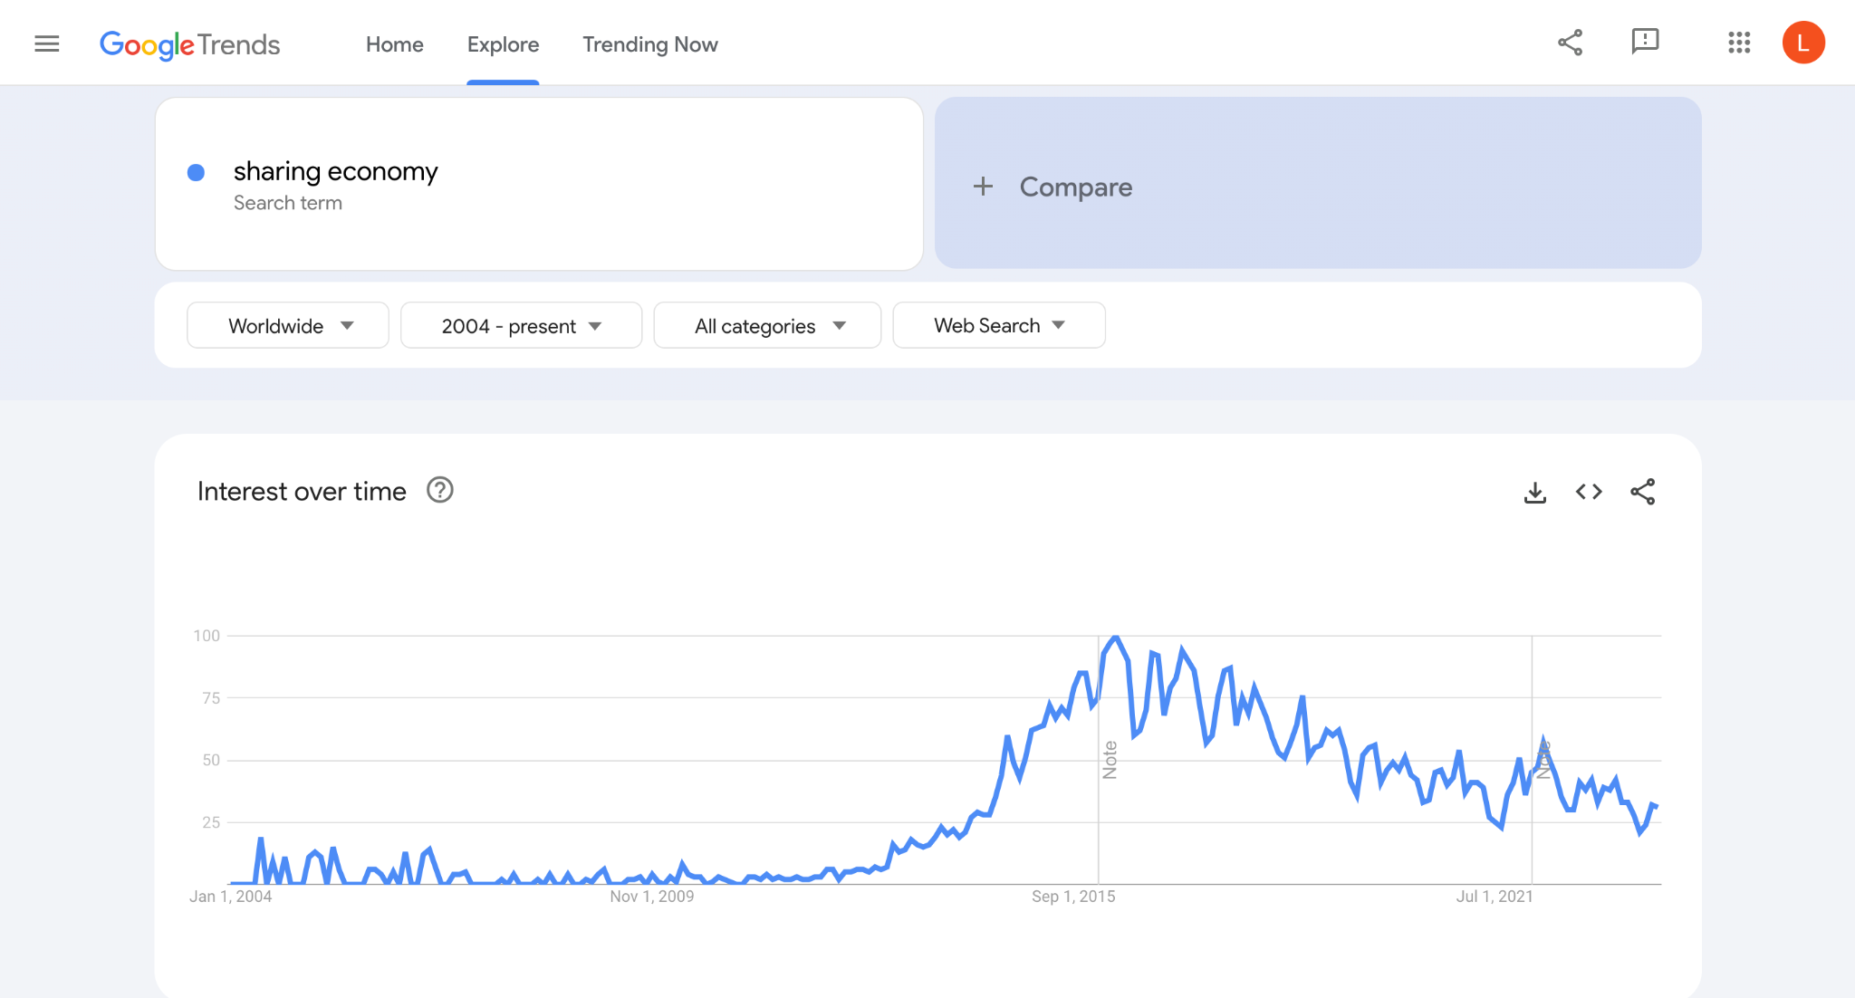
We took part in this…

Slide 44
We took part in this…
2010
AUSTERITY

Slide 45
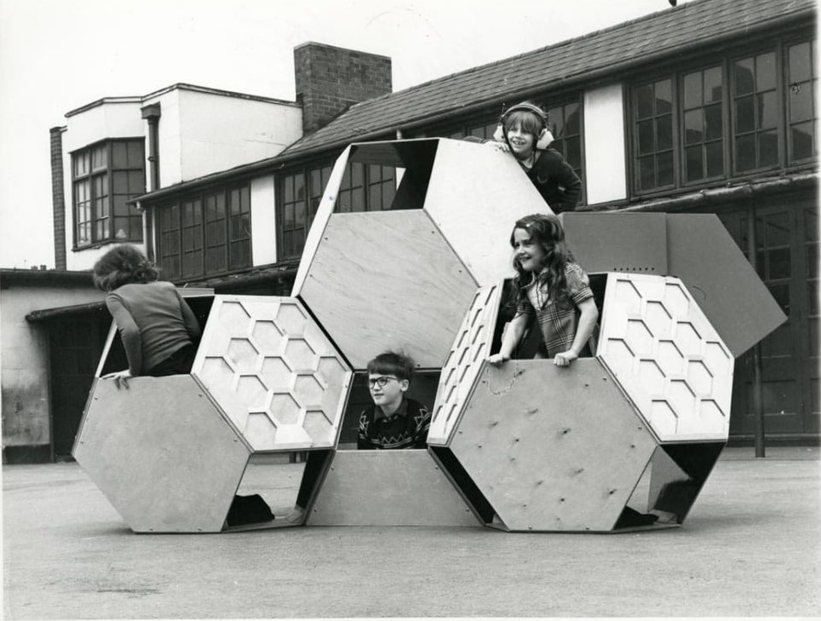
There are professions more harmful than industrial design, but only a very few of them
Victor Papeneck

Slide 46
There are professions more harmful than industrial design, but only a very few service design is one of them
Victor Papanek (+ Lou Downe)

Slide 47
The law isn’t going
to save us

Slide 48
2019

Slide 49

Vs 🇫🇷

Slide 50
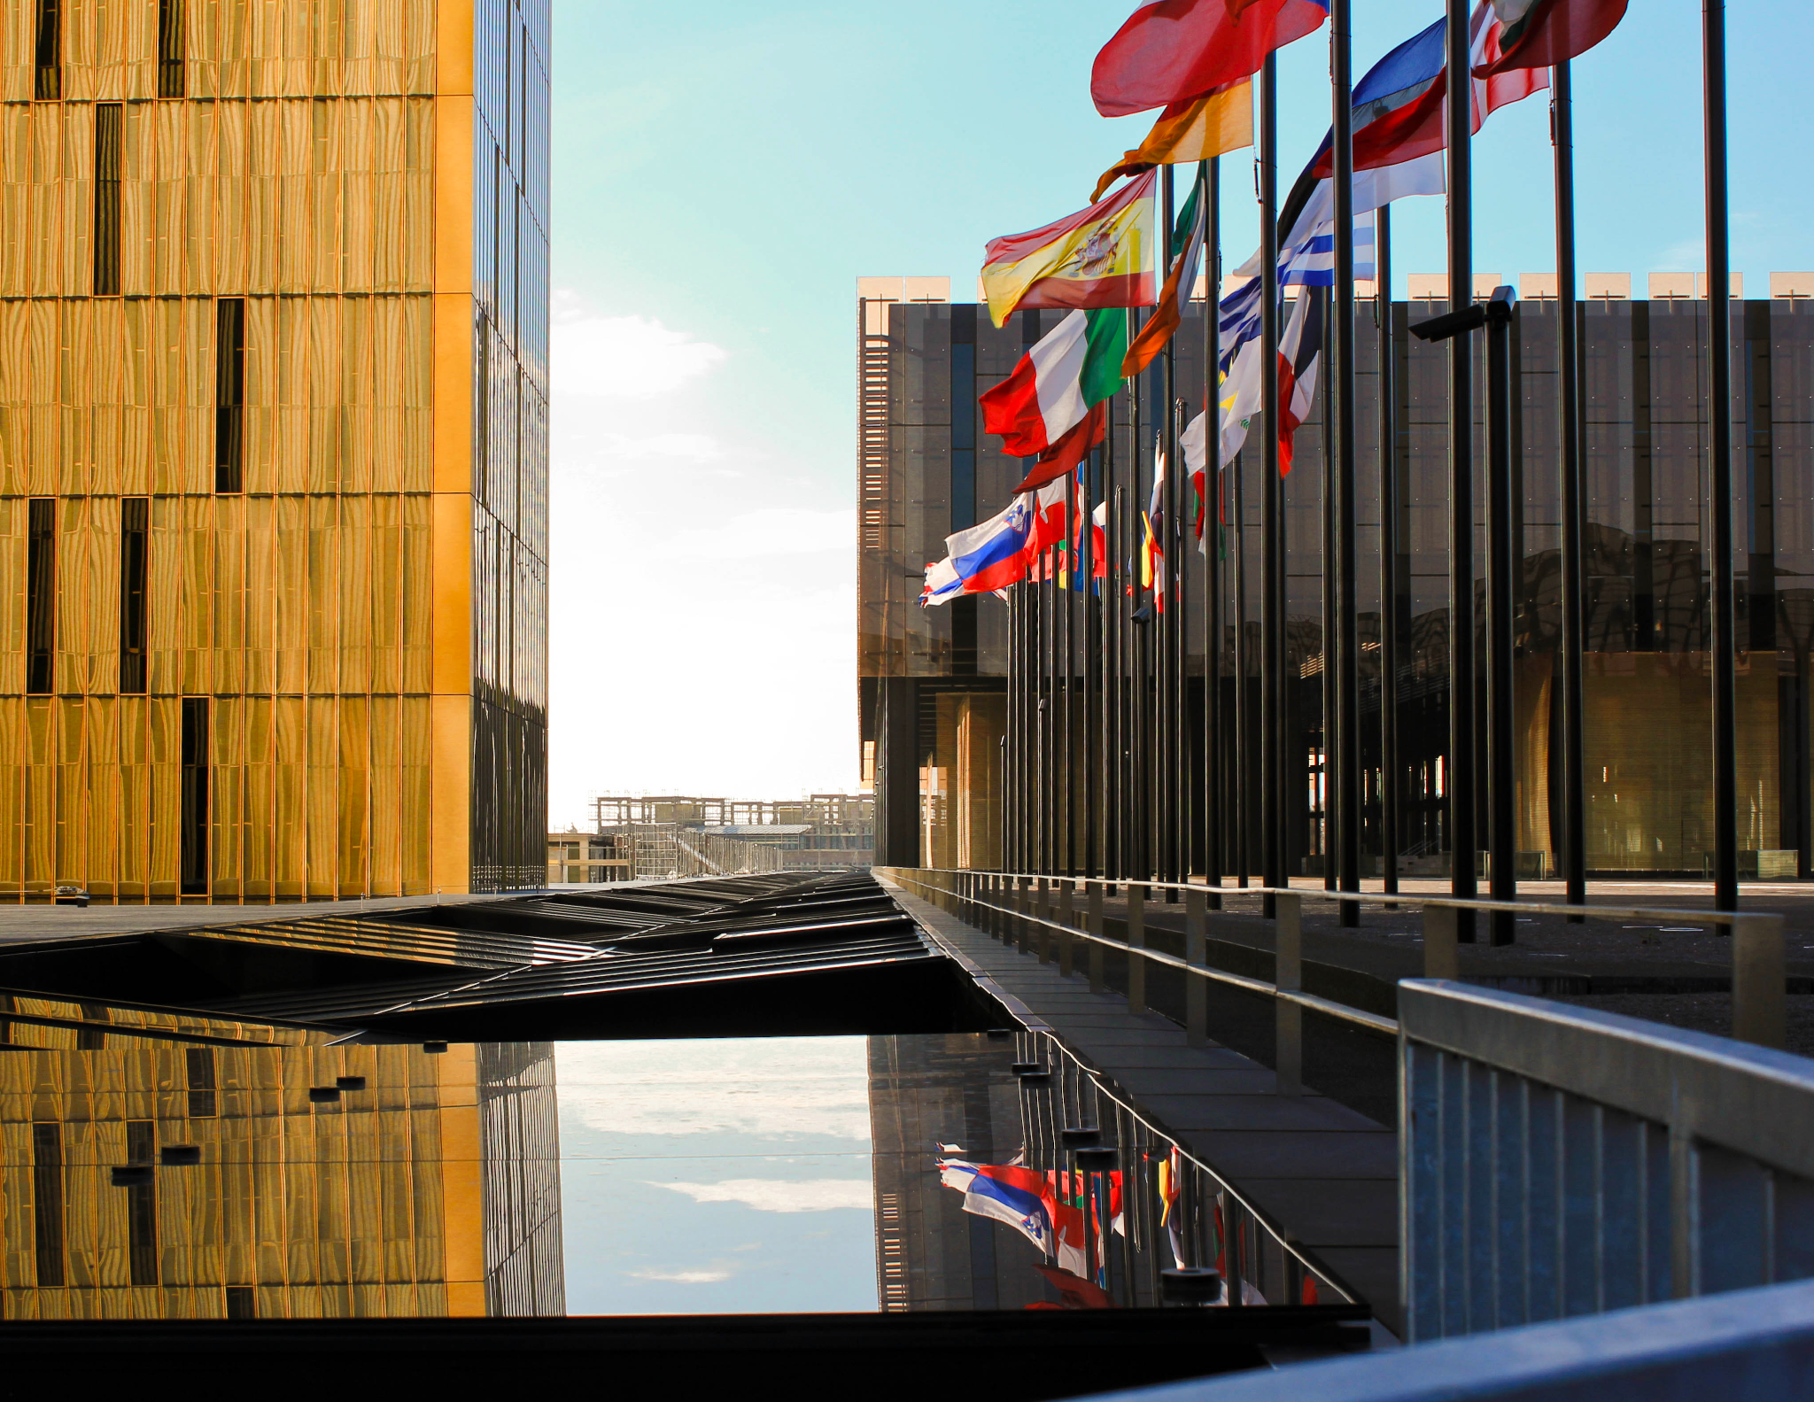
Information Society Service
To do: refine

Slide 51
Hoguet Law
Information Society Service
To do: refine

Slide 52
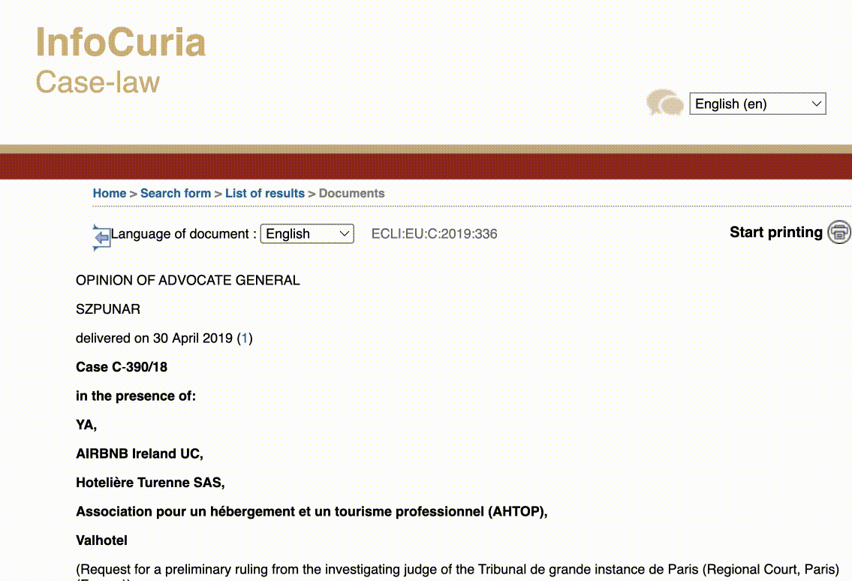

Slide 53
Hoguet Law
Information Society Service
Information Society Service
To do: refine

Slide 54
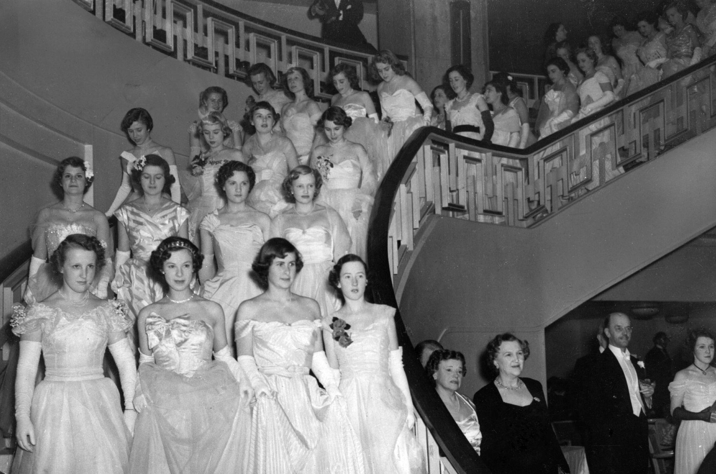

Slide 55
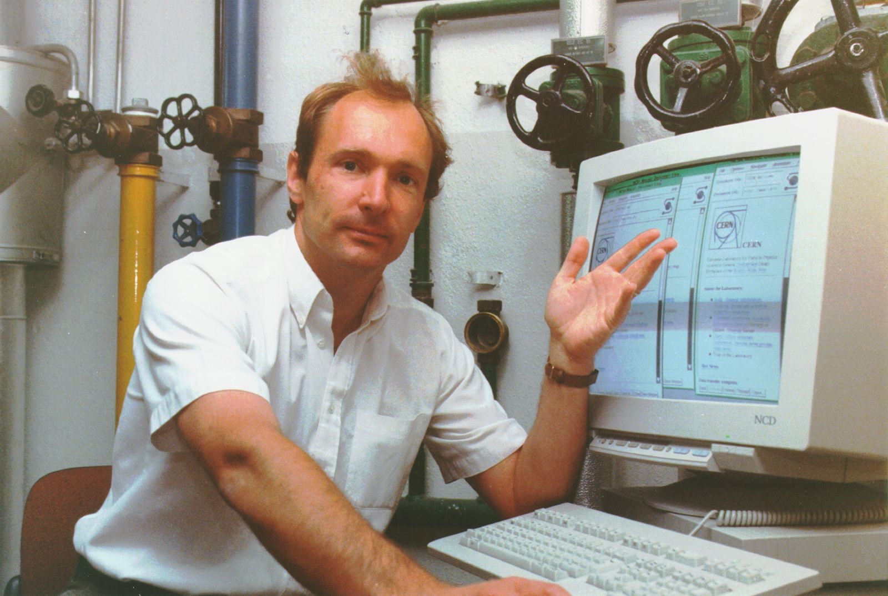

Slide 56
“Service normally provided for remuneration at a distance by electronic means at the individual request of the recipient of the services”
Information society service

Slide 57
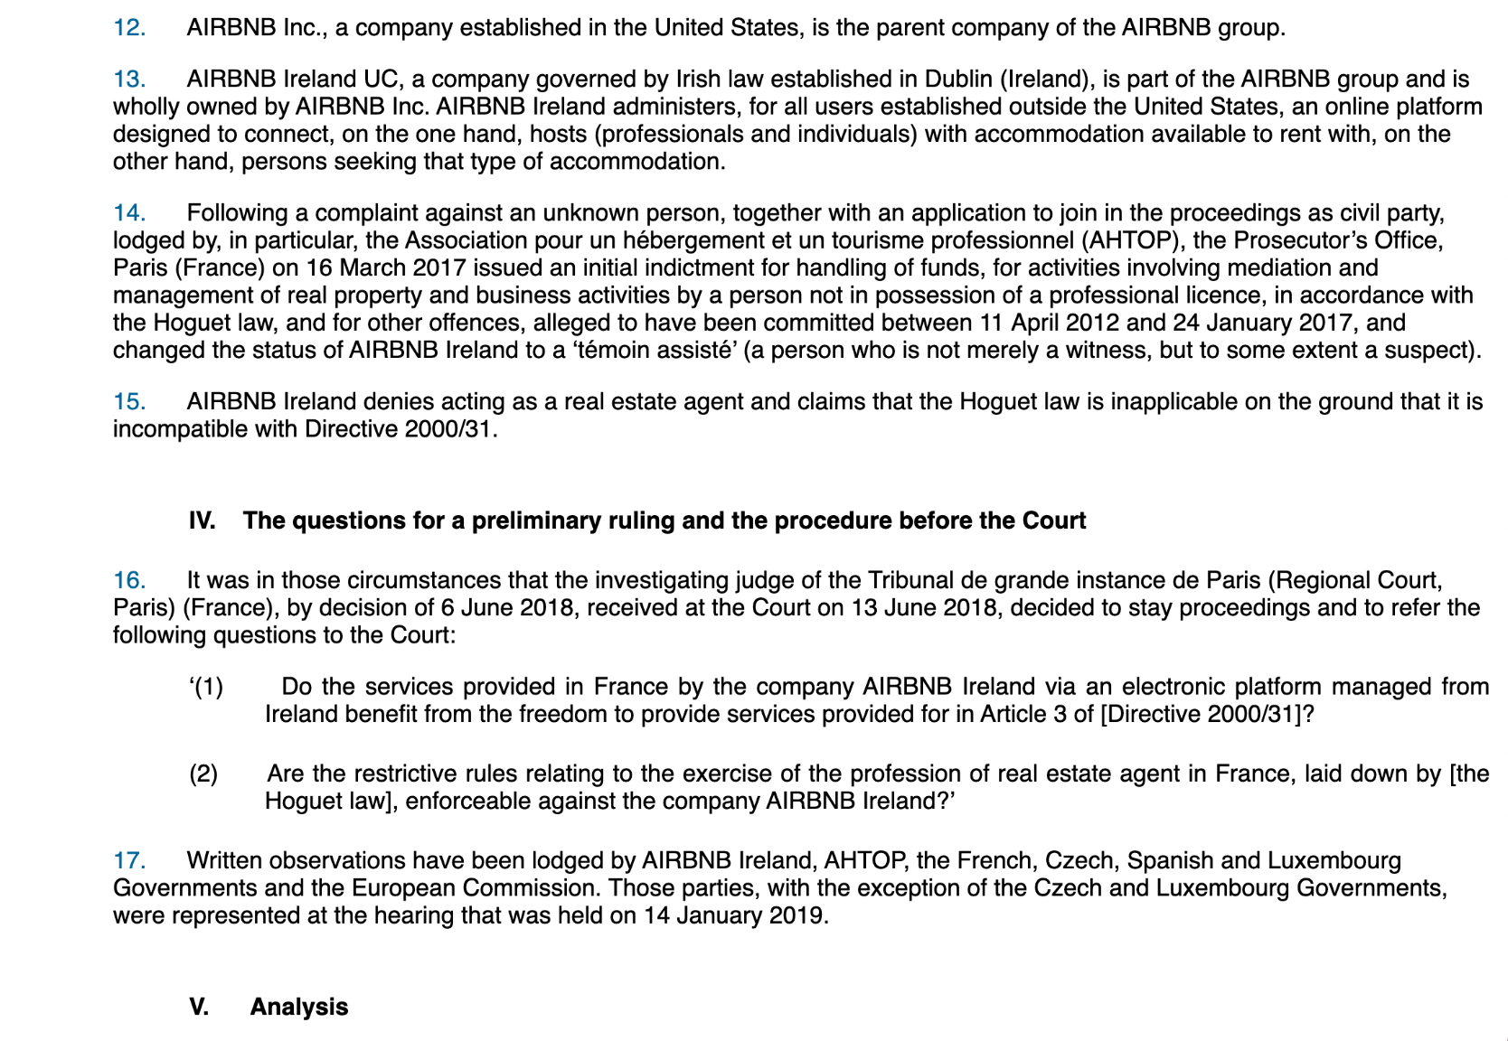

Slide 58
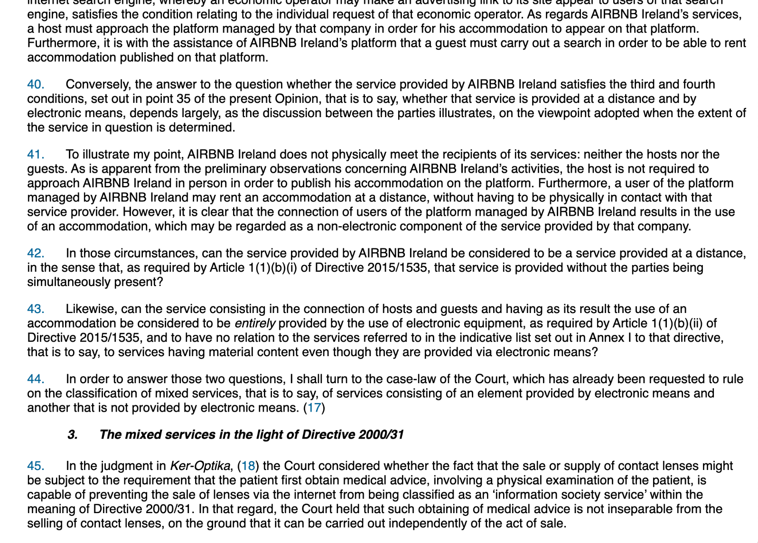

Slide 59
ie. if you don’t own the thing itself you’re not responsible for what happens as a result of people using that thing

Slide 60
laws represent what
we already believe

Slide 61
We believe that being a service allows us to break rules that we apply to everything else

Slide 62
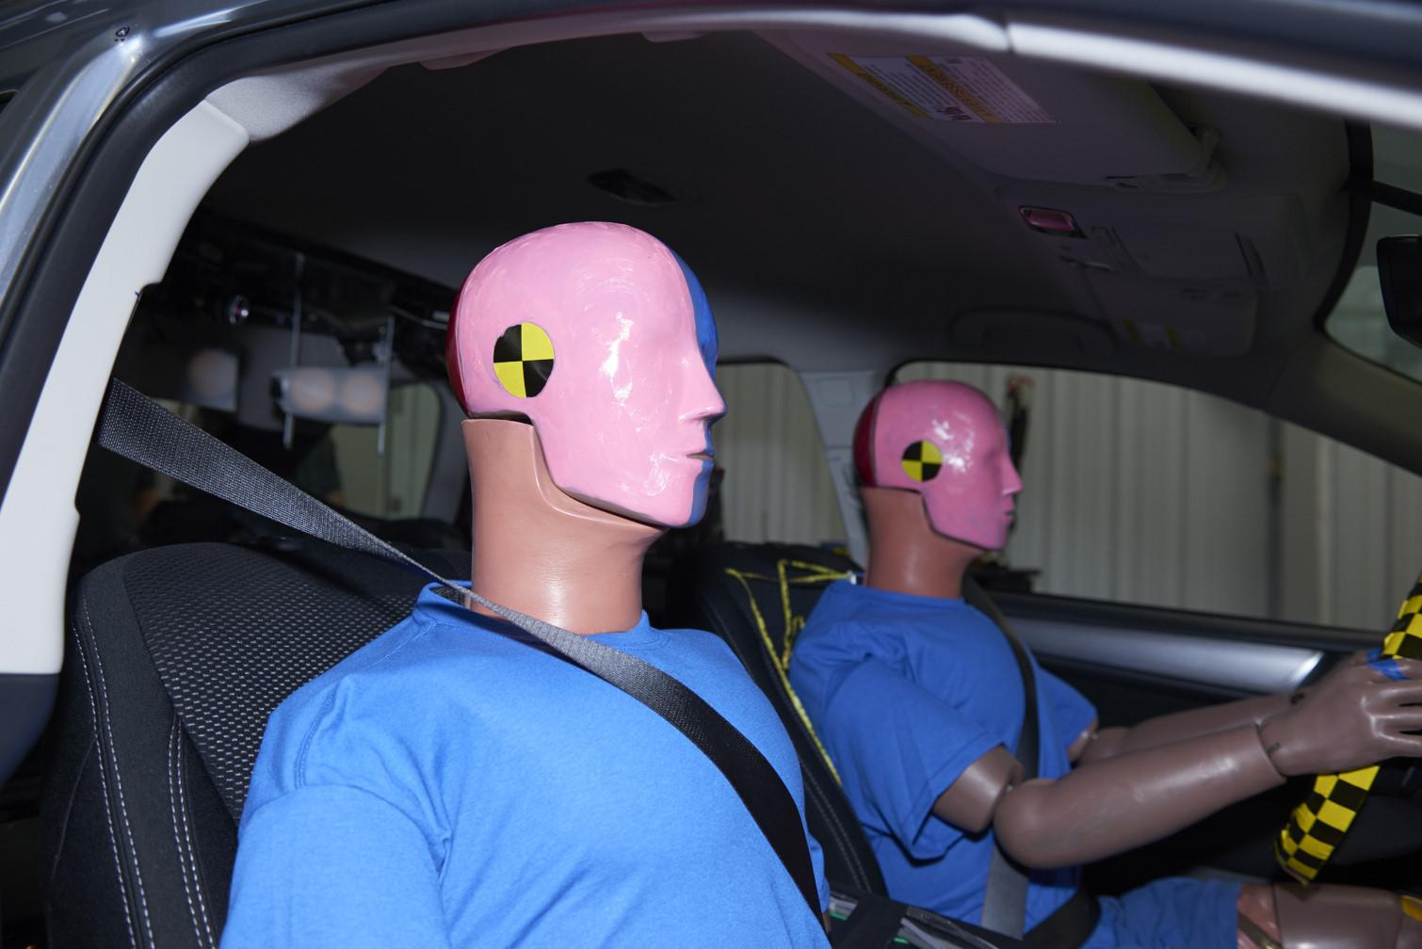

Slide 63
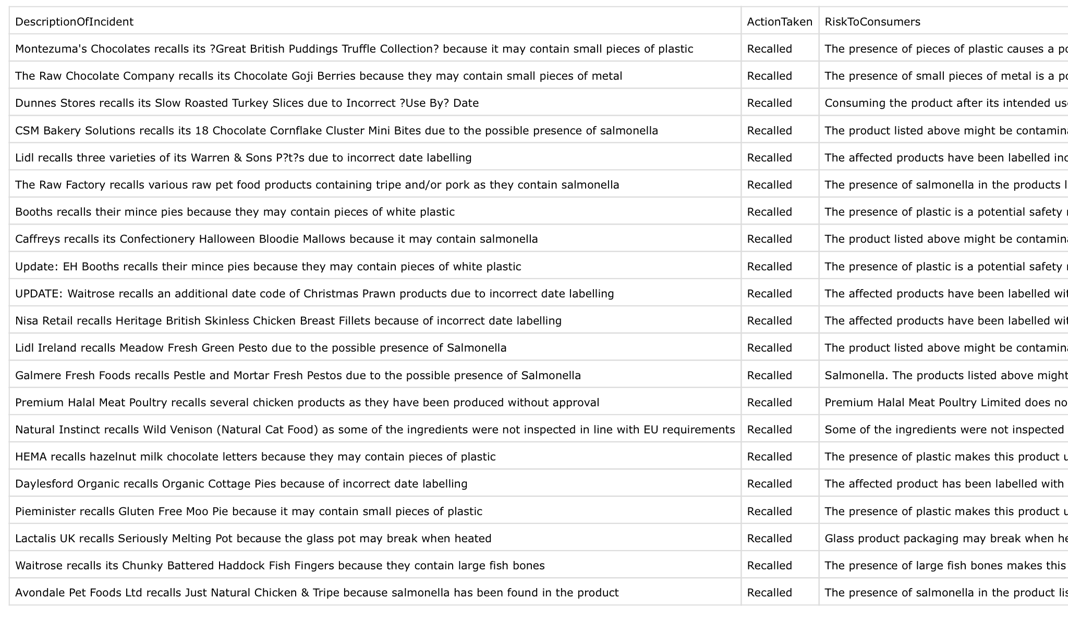

Slide 65
BS 6008
ISO 3103
☕️

Slide 66
We don’t hold services to the same standard we expect of the rest of the world

Slide 67
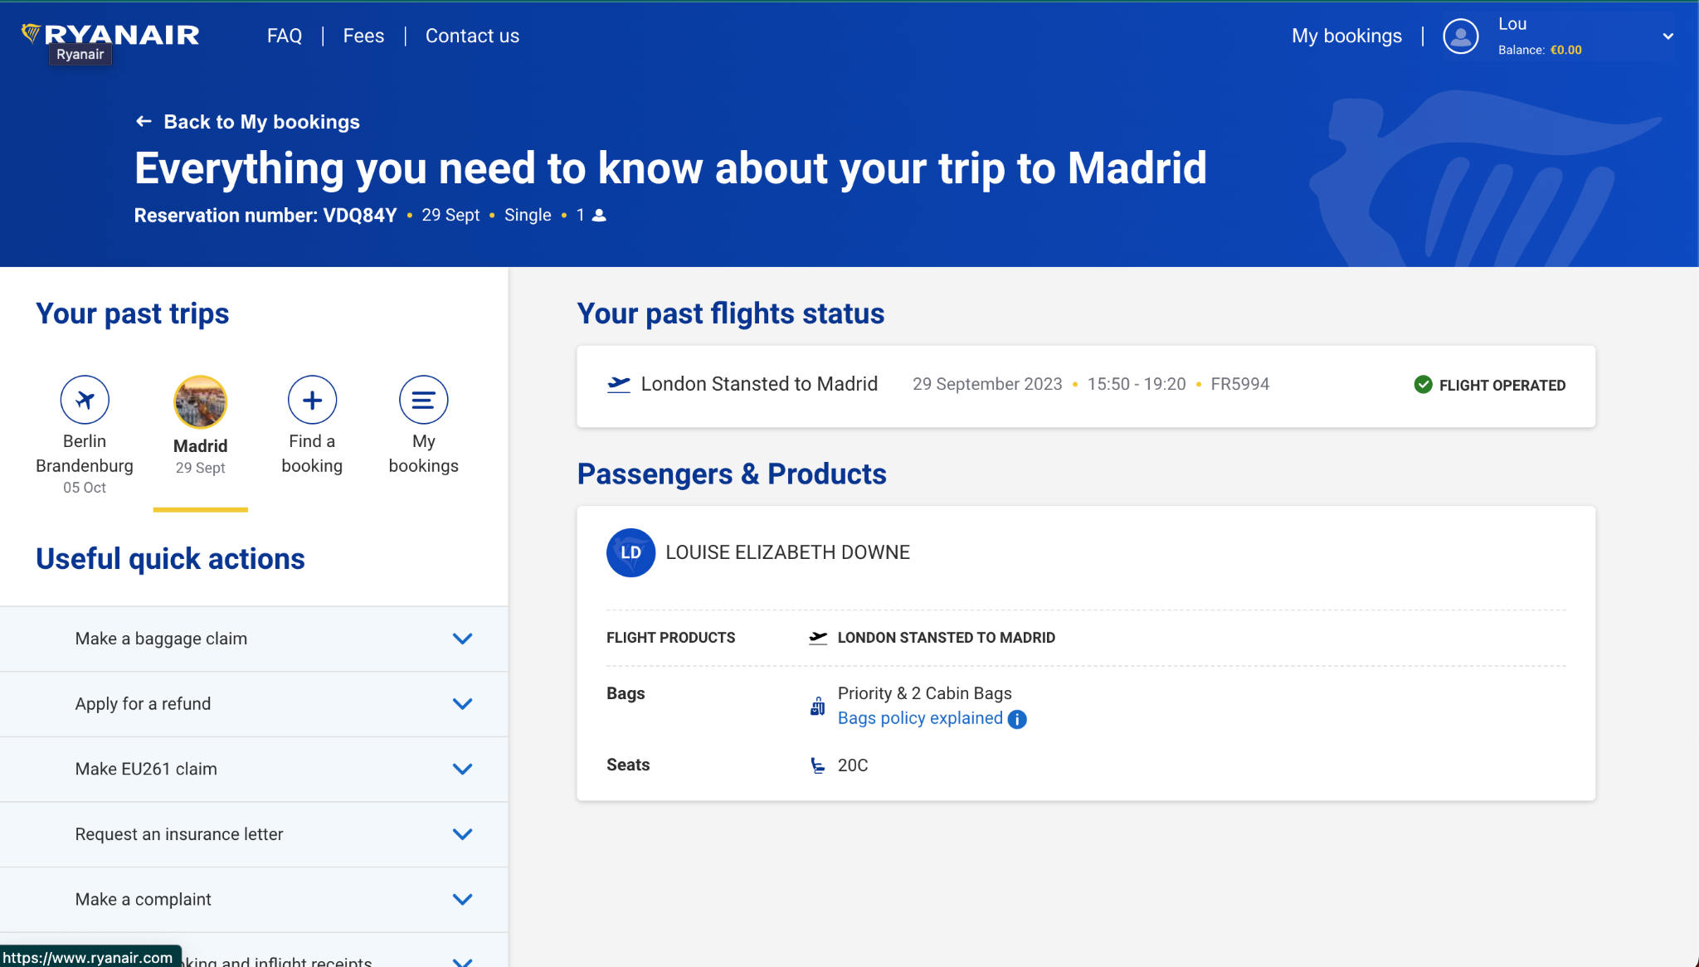
Ryanair 0 you must print your boarding pass or pay £60

Slide 68
£60 if you don’t print or save your boarding pass
Ryanair 0 you must print your boarding pass or pay £60

Slide 69
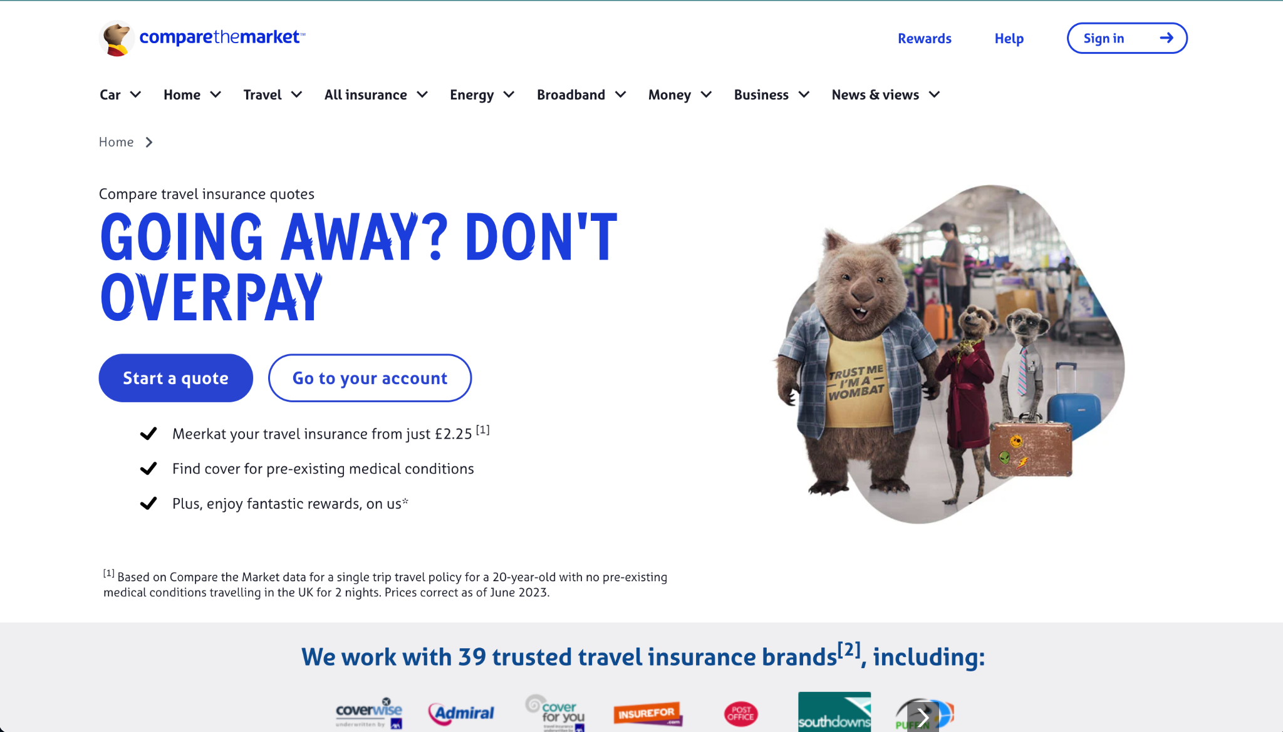

Slide 70
Guaranteed price
But if you want 24 hour claim support?!

Slide 71
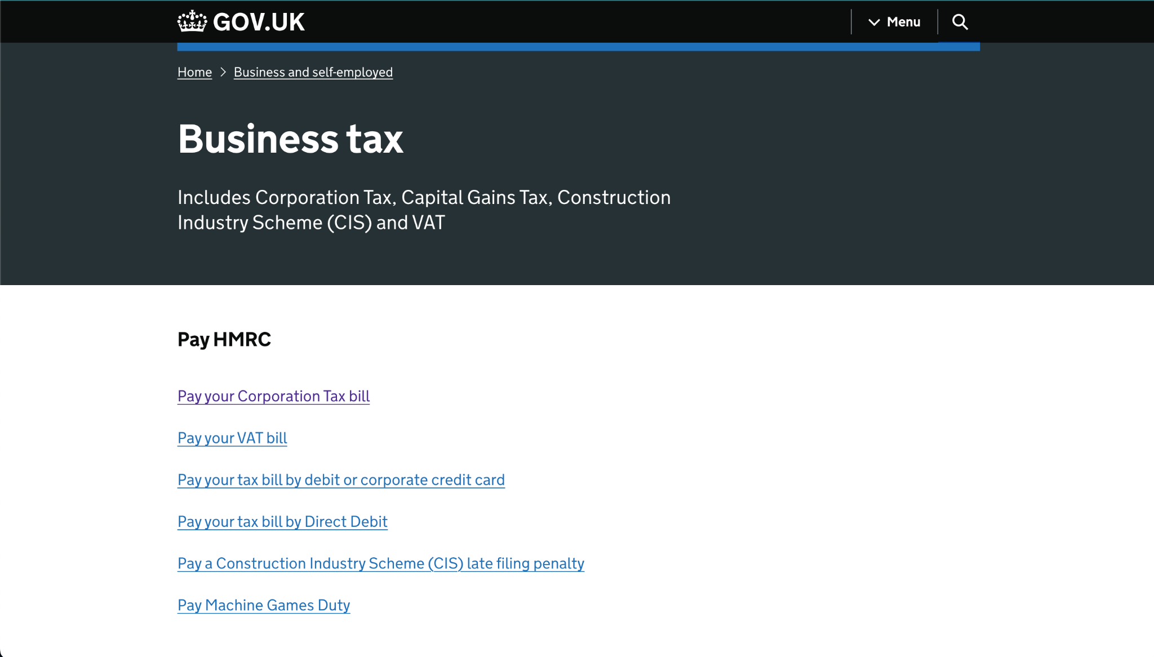

Slide 72
API only services

Slide 73
API only services

Slide 74
Privatised with
no media coverage

Slide 75
How do we get out
of this mess?!

Slide 76
Service literacy

Slide 77
What does it mean
to provide a service?

Slide 78
What standards do we hold ourselves to?

Slide 79
3 things

Slide 80
Seeing services

Slide 81
What is the one type of design where we don’t know what we’re actually designing?!

Slide 82
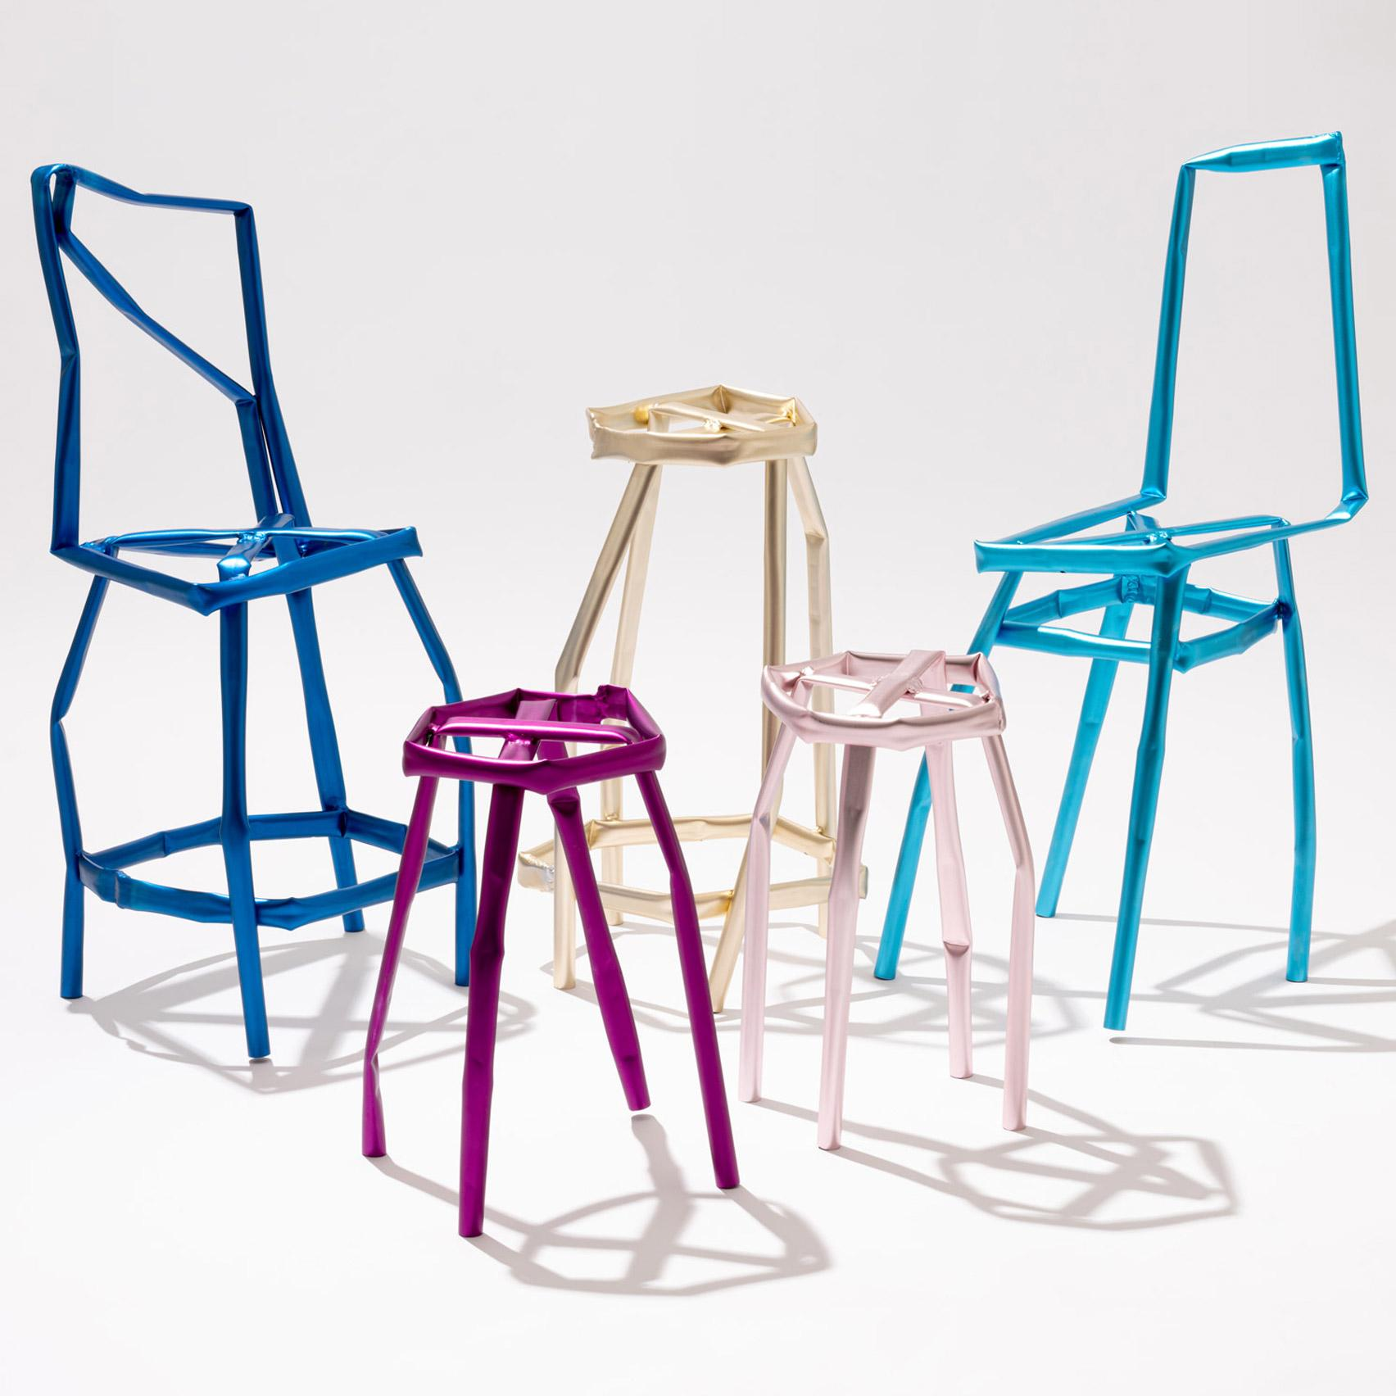
Yeon
Jinyeong

Slide 83
A service is something that helps someone to
do something

Slide 84
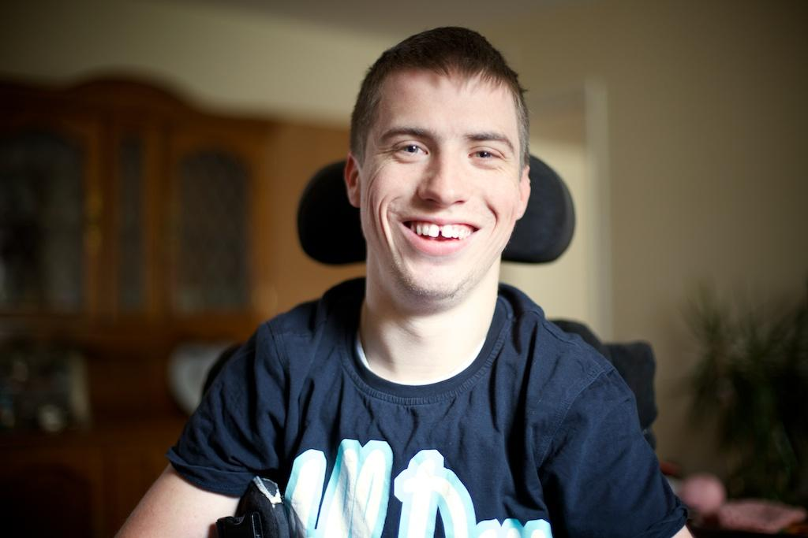
Sell a car
Learn to drive

Slide 85
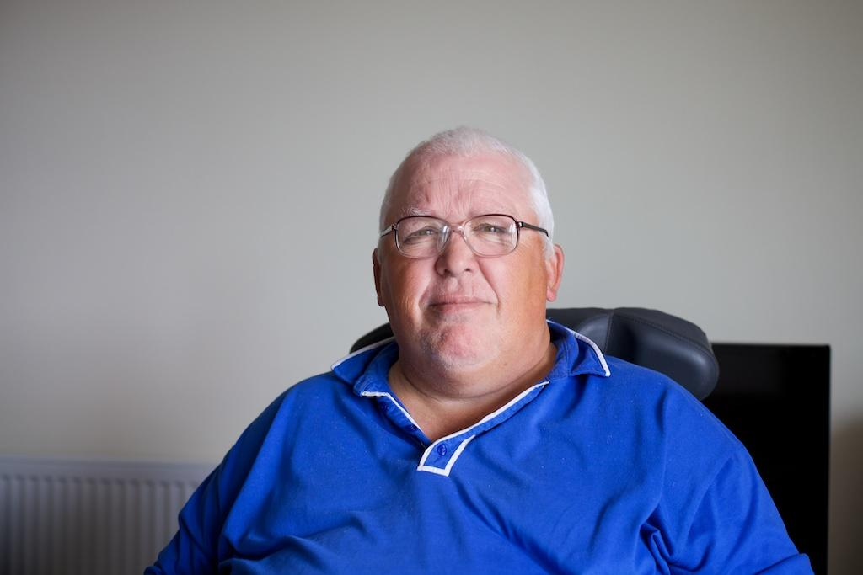
Buy a car

Slide 86
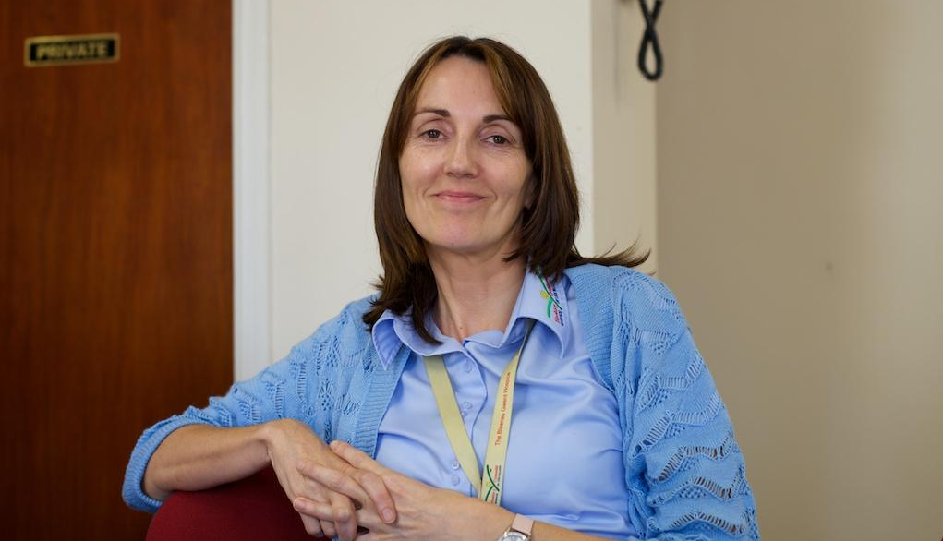
Employ
someone

Slide 87
Our user gets to decide what the service is

Slide 88
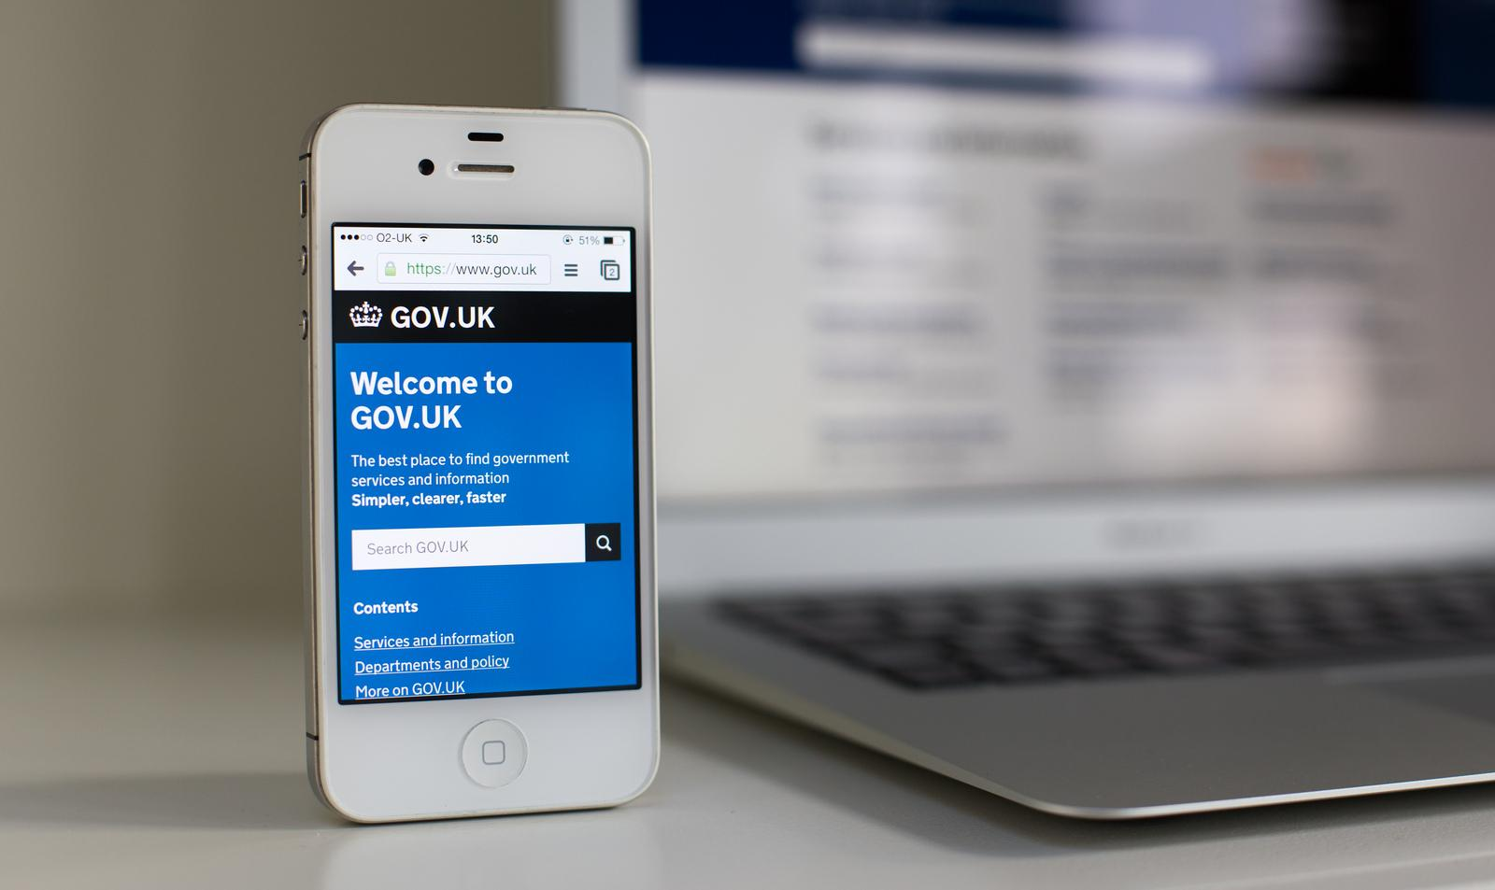
10k services
25 departments
418,343 people
Notes:
The home of all of those services is gov.uk

Slide 89
10k services
25 departments
418,343 people
500,000 pages
1.7m visits per week
Notes:
With about 500,000 pages its host to everything frm taxes to imigration, births and beekeeping

Slide 90
10k services
25 departments
418,343 people
Almost no visits
to the home page
Notes:
With about 500,000 pages its host to everything frm taxes to imigration, births and beekeeping

Slide 91
Reporting of Injuries, Diseases and Dangerous Occurrences Regulations 1995 (RIDDOR)
Registrations for Knowledge Transfer Network (KTN)/connect access (MEMBERS)
Request for a further search under section 17(6) or payment for a supplementary certificate under section 17(8)/Request for search (F9/F9A)
Employer Ownership Pilot (EOP)
Well Operations Notification System (WONS): consents and notifications
Charity Letter Forwarding Service

Slide 92

A.R.A.M.S
Notes:
My favourite is still ARAMS (a Defra service that traces sheep and cattle)

Slide 93
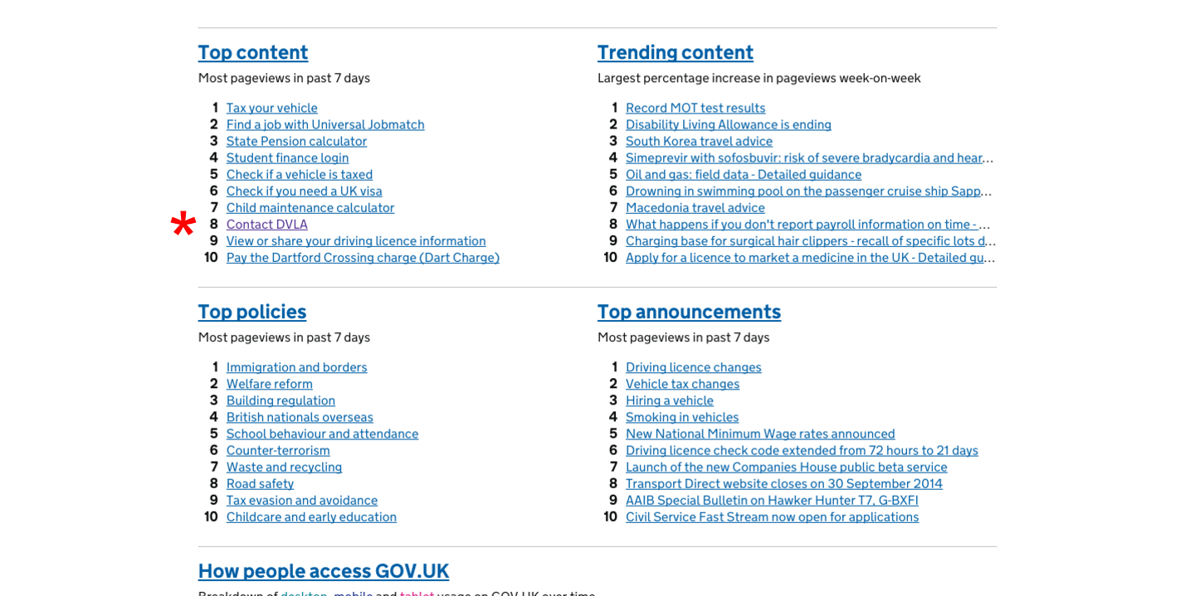
GDS

Slide 94
The 8th most popular service on GOV.UK is a phone number

Slide 95
Google is the home page to your service

Slide 96
#GOOGLEFAIL

Slide 97
Good services are verbs
Bad services are nouns

Slide 98
Learn to drive
Get a pension
See a doctor about my health concern
not
S.O.R.N
Charity Letter Forwarding Service
ePortal, MyAccount, iHub…

Slide 99
When we think about services as verbs they
get bigger

Slide 100
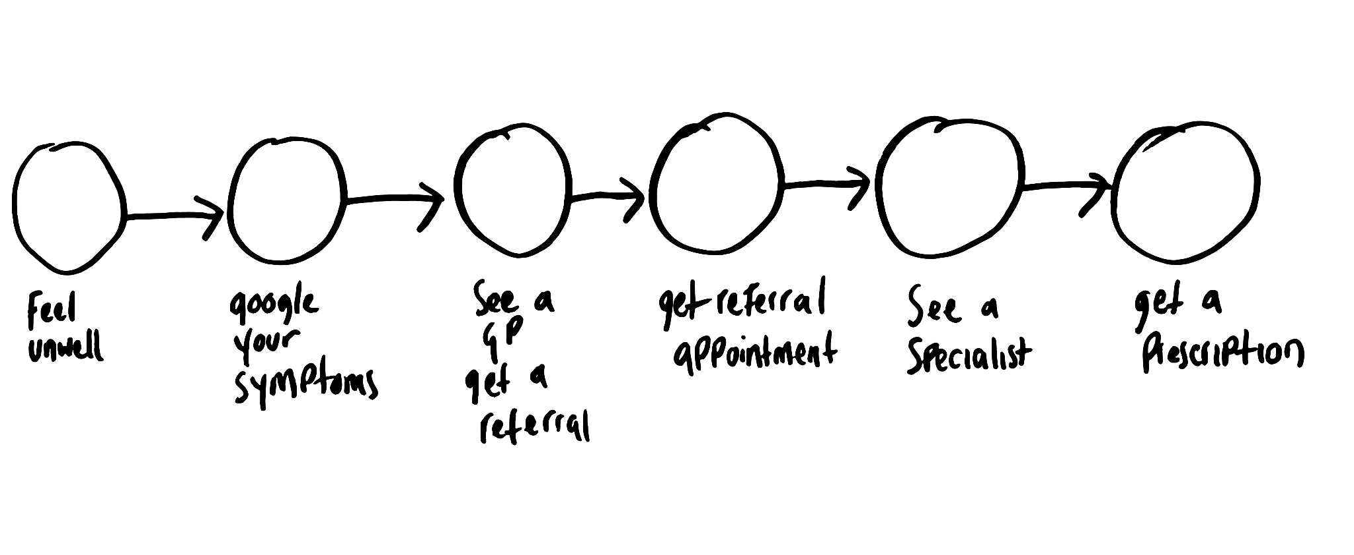

Slide 104
No one owns this

Slide 105
Services are shared

Slide 106
Services are invisible

Slide 107
Services aren’t designed

Slide 108
When we don’t design
our services we force
our users to

Slide 109
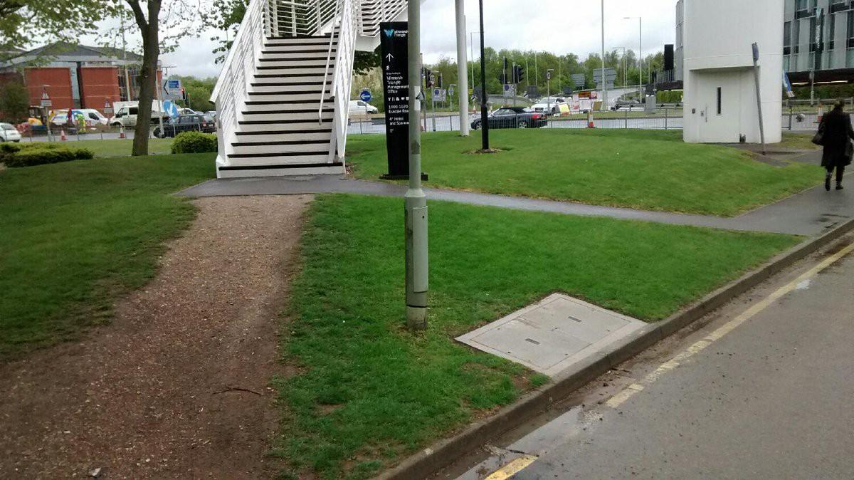

Slide 110
Our users are often the only ones who know how our services work

Slide 111
The cycle service doom

Slide 112
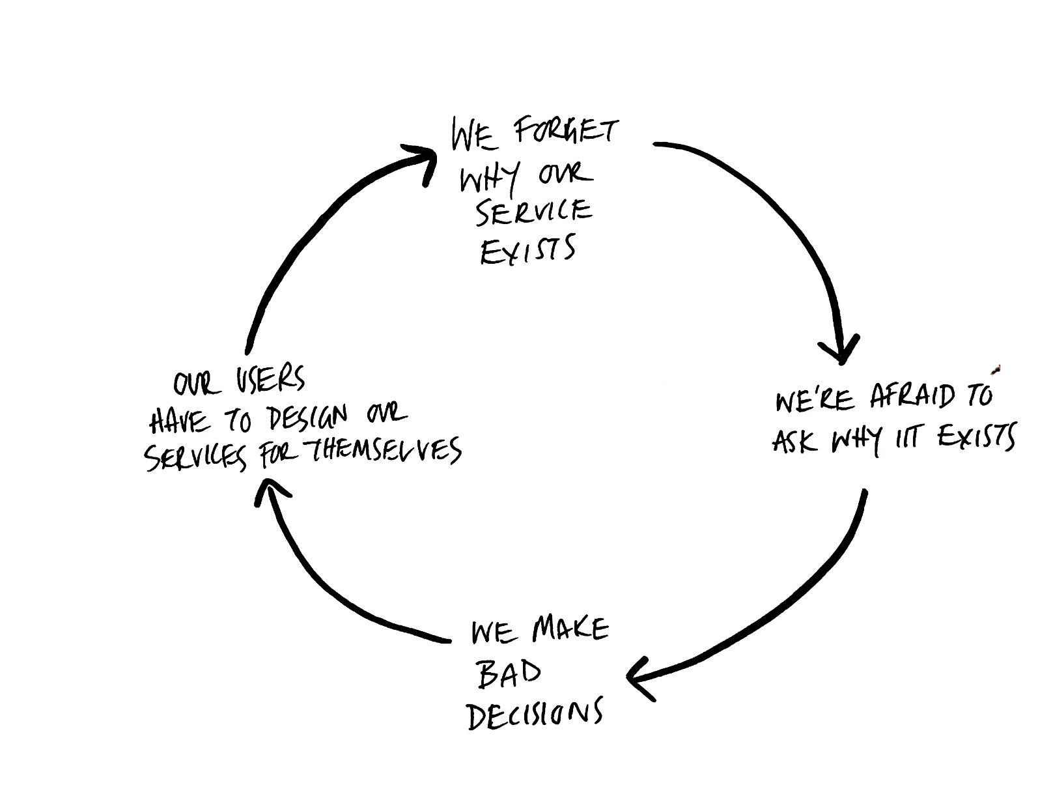

Slide 117
Before we can design anything we have to acknowledge that it exists

Slide 118
The first rule of service design is to agree what the service is that we’re designing

Slide 119
The first skill of a service designer is to be able to
explain what a service is

Slide 120
Seeing services

Slide 121
Seeing services
Understanding what makes
a good service
Committing to design them

Slide 122
“It depends”

Slide 123
“It depends”

Slide 124
There are some things that everyone needs from every service

Slide 125
To be able to find it

Slide 126
To use without having to already be an expert in how it works

Slide 127
To be able to complete it from start to finish with no dead ends

Slide 128
15 principles
of good service design

Slide 129
A Good Service
Is easy to find
Enables a each user to complete the outcome they set out to
Clearly explains its purpose
Sets the expectations a user has of it
Works in a way that’s familiar
Requires no prior knowledge to use
Is agnostic of organisational structures
Requires the minimum possible
steps to complete
Is consistent throughout
Has no dead ends
Is usable by everyone, equally
Encourages the right behaviors from users and staff
Responds to change quickly
Clearly explain why a decision has been made
Makes it easy to get human assistance

Slide 130
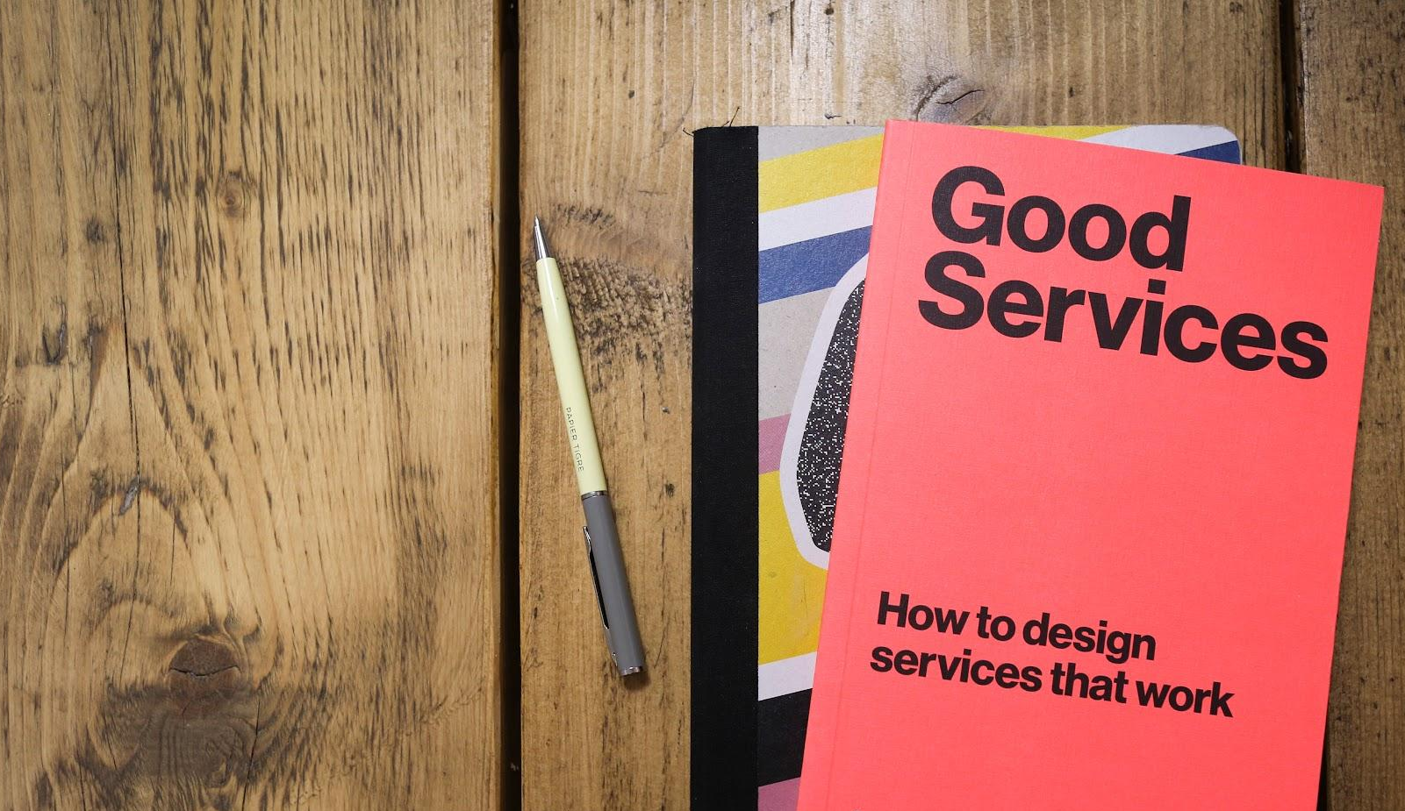
Good
Services
School
Notes:
I work here

Slide 131
Seeing services
Understanding what makes
a good service
Committing to design them

Slide 132
Service design is 10% design
Notes:
I work here

Slide 133
Service design is 10% design
90% creating the conditions
for service design to happen
Notes:
I work here

Slide 134
90% creating the conditions
for service design to happen
Notes:
I work here

Slide 135
Everything in your organisation affects
your service

Slide 136
Data
Governance
Financial model
Procurement processes
Skills and recruitment
Culture
Policy
Business model
...etc

Slide 137
“It depends”

Slide 138
“It depends”

Slide 139
There are some things that everyone needs from every service

Slide 140
There are some things that everyone needs from every service
There are some things that every organisation needs to deliver any
service

Slide 141
Understanding who your users are and what they need from you

Slide 142
Remembering the purpose of your service and what you’re trying to achieve

Slide 143
Knowing how well your service is performing

Slide 144
Allowing staff the freedom to learn and respond to what they learn

Slide 145
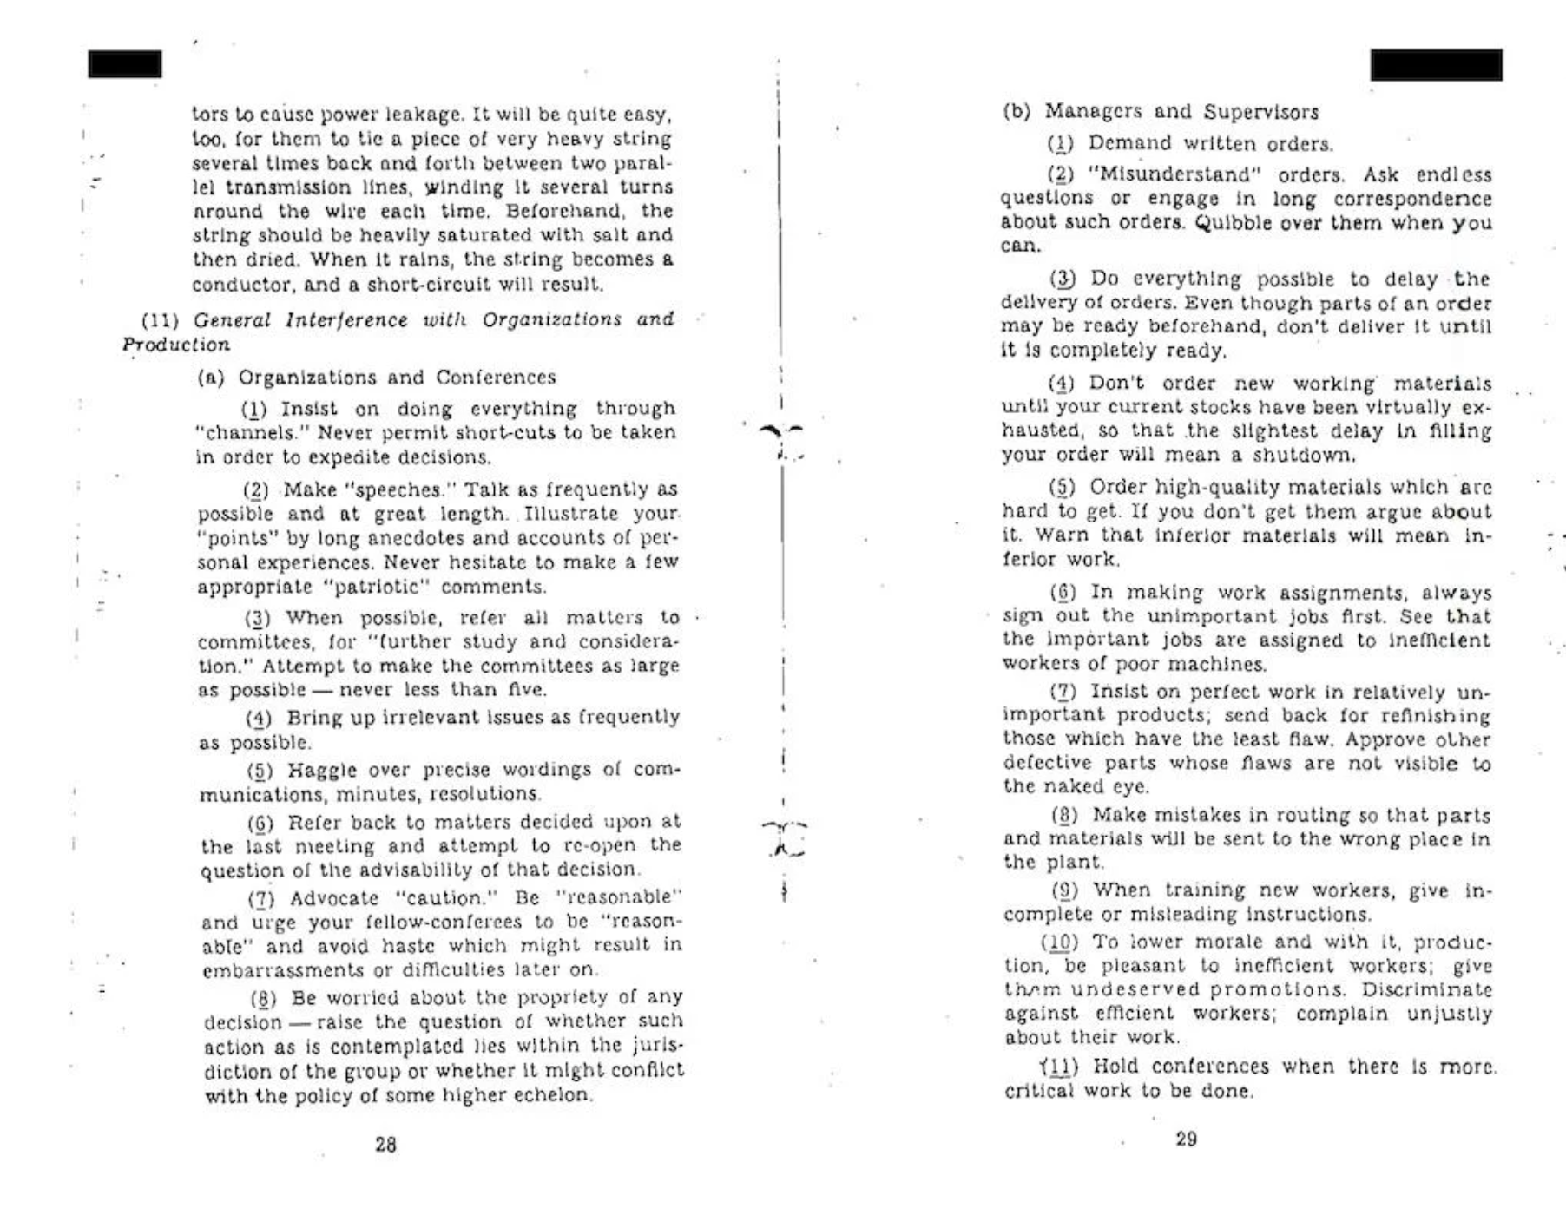
CIA Simple Sabotage Field Manual, 1944
Notes:
This is actually a well known sabotage tactic that was used by the CIA in the second world war and cold war where agents sent into enemy organisations were tasked with things like….

Slide 146
CIA Simple Sabotage Field Manual, 1944
Notes:
This is actually a well known sabotage tactic that was used by the CIA in the second world war and cold war where agents sent into enemy organisations were tasked with things like….

Slide 147
CIA Simple Sabotage Field Manual, 1944
Notes:
“Bring up issues as frequently as possible” or…

Slide 148
CIA Simple Sabotage Field Manual, 1944
Notes:
“Bring up issues as frequently as possible” or…

Slide 149
Confidence

Slide 150
Confidence
The skills to deal with the reality of service design

Slide 151
What is stopping
us from delivering services that work?!

Slide 152
The 10 causes
of bad service design

Slide 153
10 Causes of Bad Services
You don’t know what your service is

Slide 154
10 Causes of Bad Services
You don’t know what your service is
You’ve forgotten why you’re doing what you’re doing

Slide 155
10 Causes of Bad Services
You don’t know what your service is
You’ve forgotten why you’re doing what you’re doing
You don’t understand the constraints of your materials

Slide 156
10 Causes of Bad Services
You don’t know what your service is
You’ve forgotten why you’re doing what you’re doing
You don’t understand the constraints of your materials
The risk of doing something outweighs the risk of doing nothing

Slide 157
10 Causes of Bad Services
You don’t know what your service is
You’ve forgotten why you’re doing what you’re doing
You don’t understand the constraints of your materials
The risk of doing something outweighs the risk of doing nothing
You’re trying to do too much with too little

Slide 158
10 Causes of Bad Services
You don’t know what your service is
You’ve forgotten why you’re doing what you’re doing
You don’t understand the constraints of your materials
The risk of doing something outweighs the risk of doing nothing
You’re trying to do too much with too little
Your organisation wasn’t structured to deliver services

Slide 159
10 Causes of Bad Services
You don’t know what your service is
You’ve forgotten why you’re doing what you’re doing
You don’t understand the constraints of your materials
The risk of doing something outweighs the risk of doing nothing
You’re trying to do too much with too little
Your organisation wasn’t structured to deliver services
Your staff have no autonomy

Slide 160
10 Causes of Bad Services
You don’t know what your service is
You’ve forgotten why you’re doing what you’re doing
You don’t understand the constraints of your materials
The risk of doing something outweighs the risk of doing nothing
You’re trying to do too much with too little
Your organisation wasn’t structured to deliver services
Your staff have no autonomy
You have no idea how your services are performing

Slide 161
10 Causes of Bad Services
You don’t know what your service is
You’ve forgotten why you’re doing what you’re doing
You don’t understand the constraints of your materials
The risk of doing something outweighs the risk of doing nothing
You’re trying to do too much with too little
Your organisation wasn’t structured to deliver services
Your staff have no autonomy
You have no idea how your services are performing
You incentivise the wrong behaviour

Slide 162
10 Causes of Bad Services
You don’t know what your service is
You’ve forgotten why you’re doing what you’re doing
You don’t understand the constraints of your materials
The risk of doing something outweighs the risk of doing nothing
You’re trying to do too much with too little
Your organisation wasn’t structured to deliver services
Your staff have no autonomy
You have no idea how your services are performing
You incentivise the wrong behaviour
You think you can get away with it

Slide 163
10 Causes of Bad Services
You don’t know what your service is
You’ve forgotten why you’re doing what you’re doing
You don’t understand the constraints of your materials
The risk of doing something outweighs the risk of doing nothing
You’re trying to do too much with too little
Your organisation wasn’t structured to deliver services
Your staff have no autonomy
You have no idea how your services are performing
You incentivise the wrong behaviour
You think you can get away with it

Slide 164
Most services have no idea how well they’re delivering their outcome

Slide 165
Or what outcome they’re actually trying to deliver

Slide 166
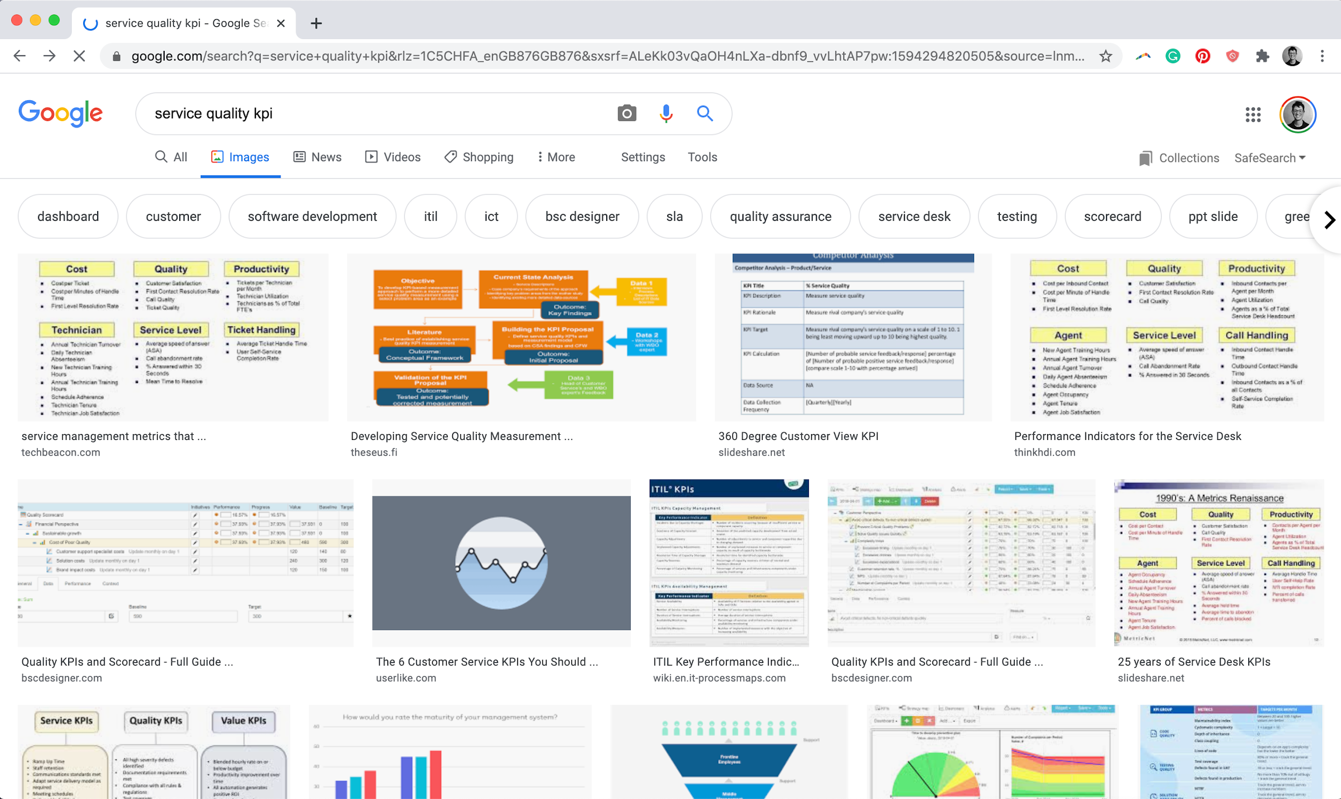
Notes:
I work here

Slide 167
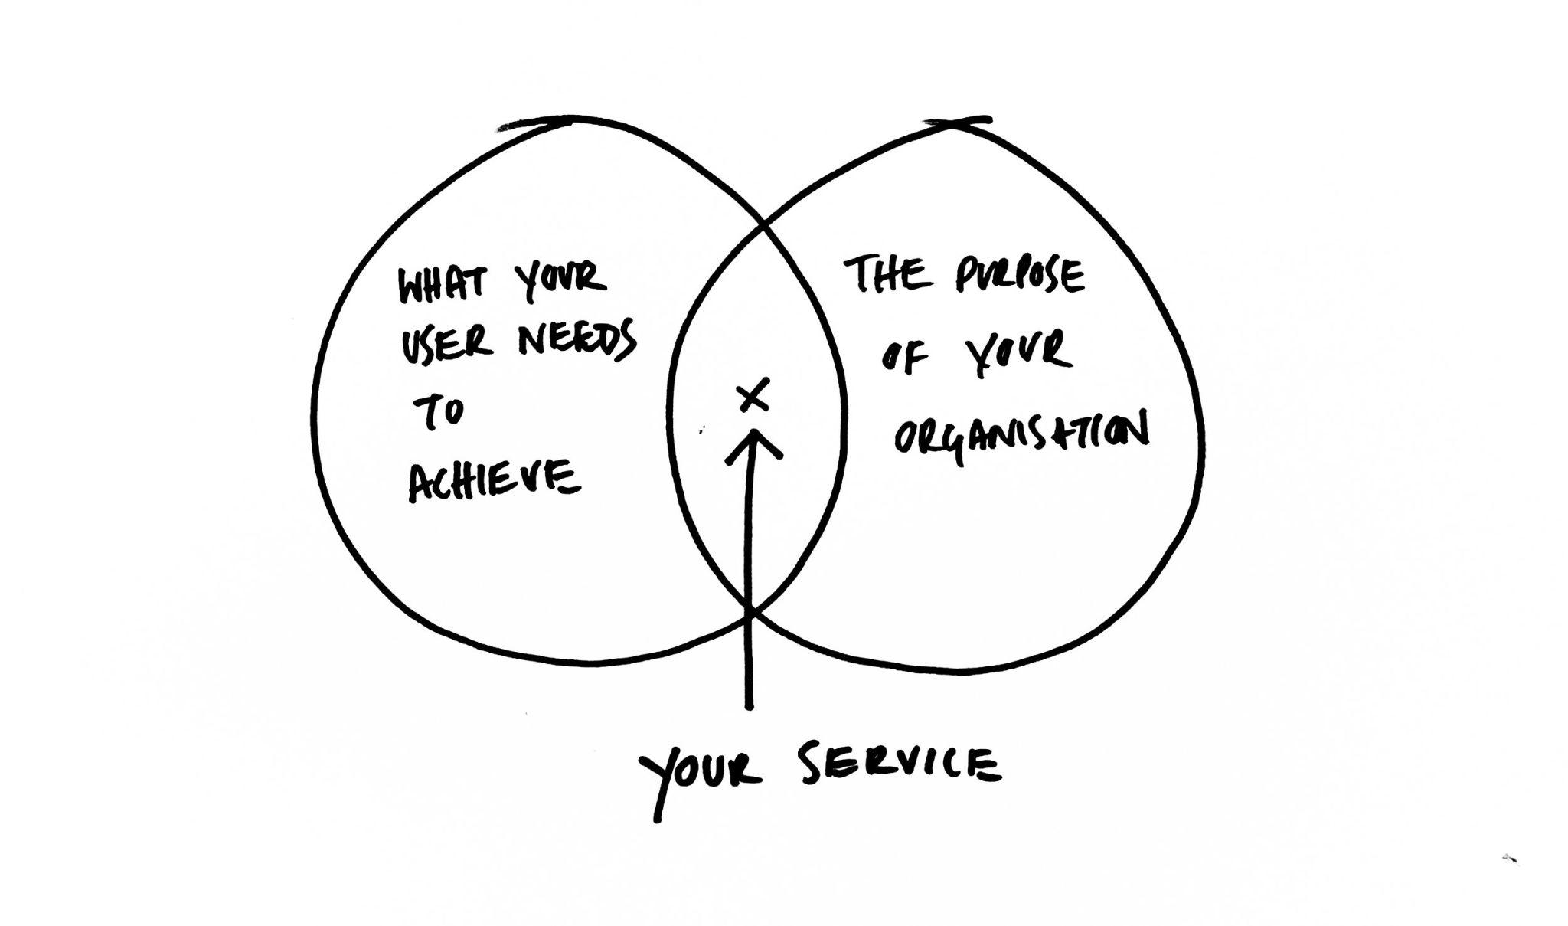

Slide 168
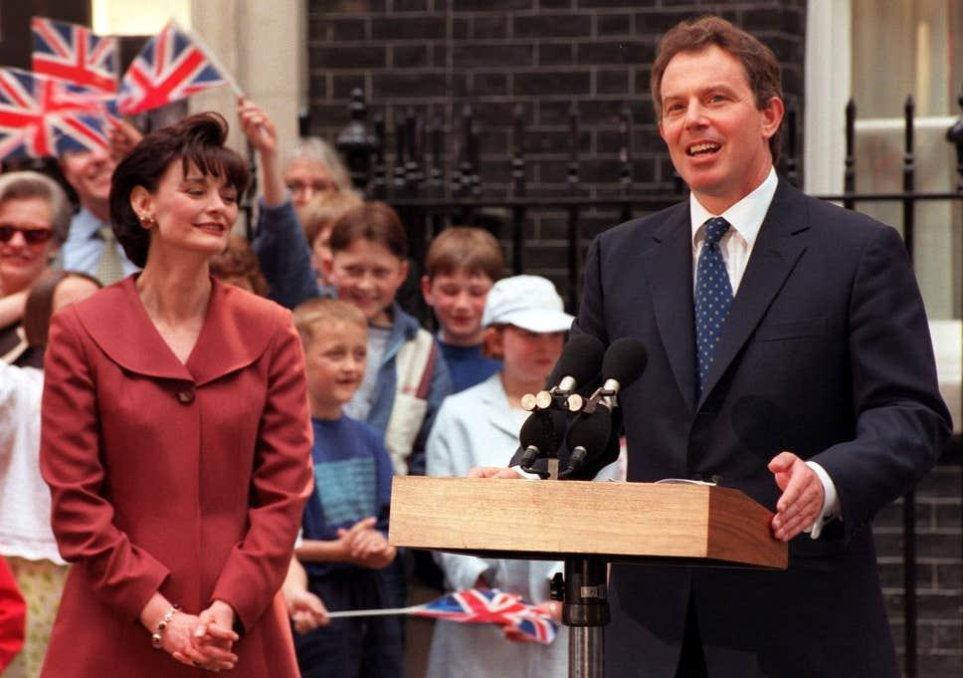
Notes:
I work here

Slide 169
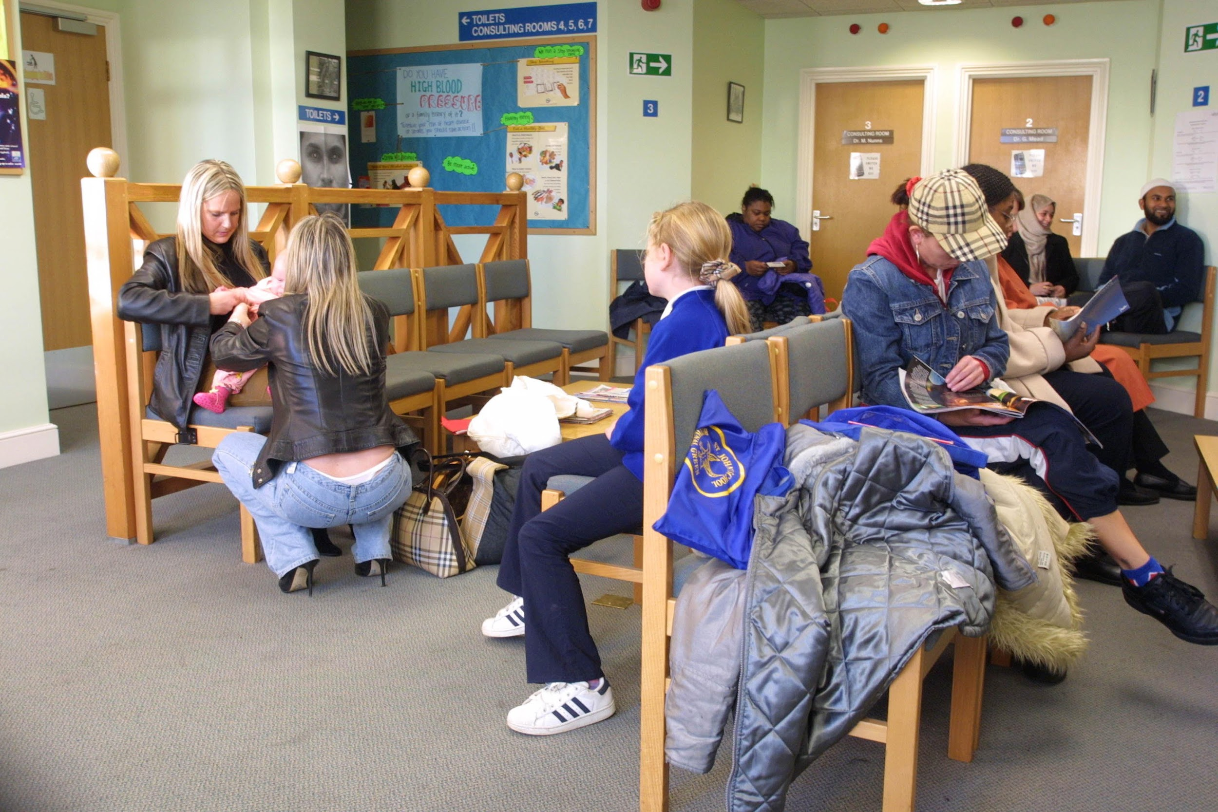

Slide 170
“Cut the waiting time to see a doctor to 48 hours”

Slide 171
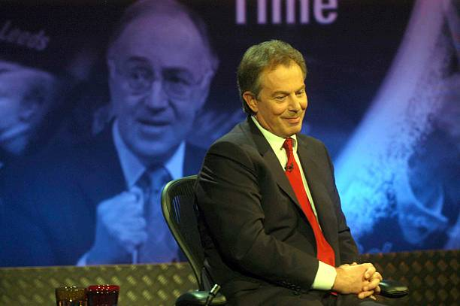
Notes:
I work here

Slide 172
“I can't make an appointment with my doctor in a week’s time because you’re only allowed to make it 48 hours beforehand. Then when I try to call on the day, and I can’t get through”
Diana Church

Slide 173
Cut the waiting time to see a doctor to 48 hours

Slide 174
Cut the waiting time to see a doctor to 48 hours
No appointment to be booked earlier than 48 hours

Slide 175
“Obviously, it shouldn’t work that way”
Tony Blair

Slide 176
What gets measured gets done

Slide 177
Measure the outcome you want to achieve,
not the task you want done

Slide 178
Service literacy

Slide 179
Seeing services
Understanding what makes
a good service
Committing to design them

Slide 180
Creating the conditions for service design is the work

Slide 181
Service design is…
A conversation
An email
A new fund
A coffee with someone
A diagram
A new structure
Changing the name of something
Renaming a business process
Changing an API
Stopping things from happening
Starting new things
A new stream of revenue
Fixing a point of failure
Giving permission for something
Organising pay rises
Clearer outcomes
Defining the edges of a service
Costing up delivery
Applying for funding
Hiring people
Spending 6 months getting money
Making friends
Making enemies
Building a community
Rage-quitting
Taking breaks
Pillow plumping
Sticker designing
Powerpoint wrangling
Tear mopping
Morale building
…….

Slide 182
This work isn’t easy

Slide 183
“The people who get stuff done are the ones who survive the longest”
My first boss in the civil service

Slide 184
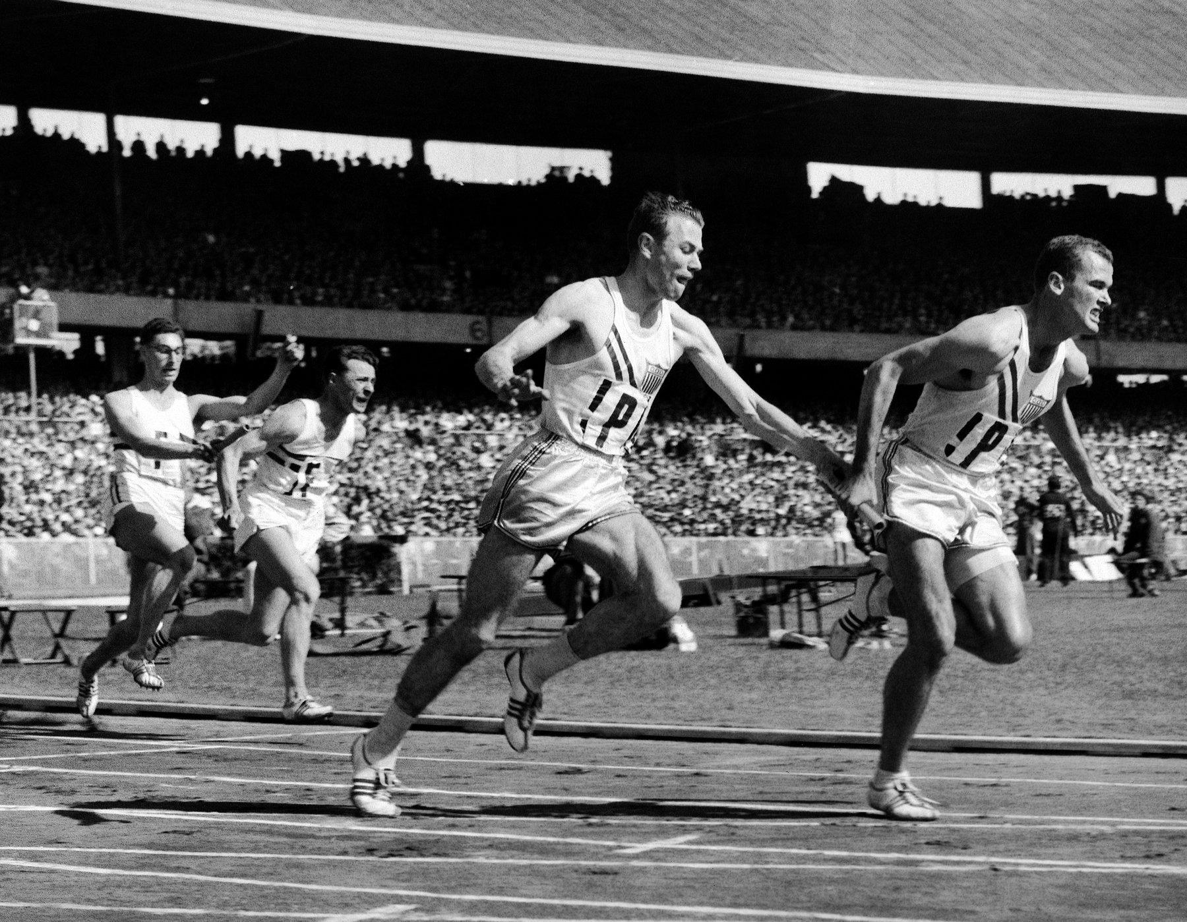
You want to go fast, go alone, you want to go far go together

Slide 185
Just because it’s hard doesn’t mean it has to be complicated

Slide 186
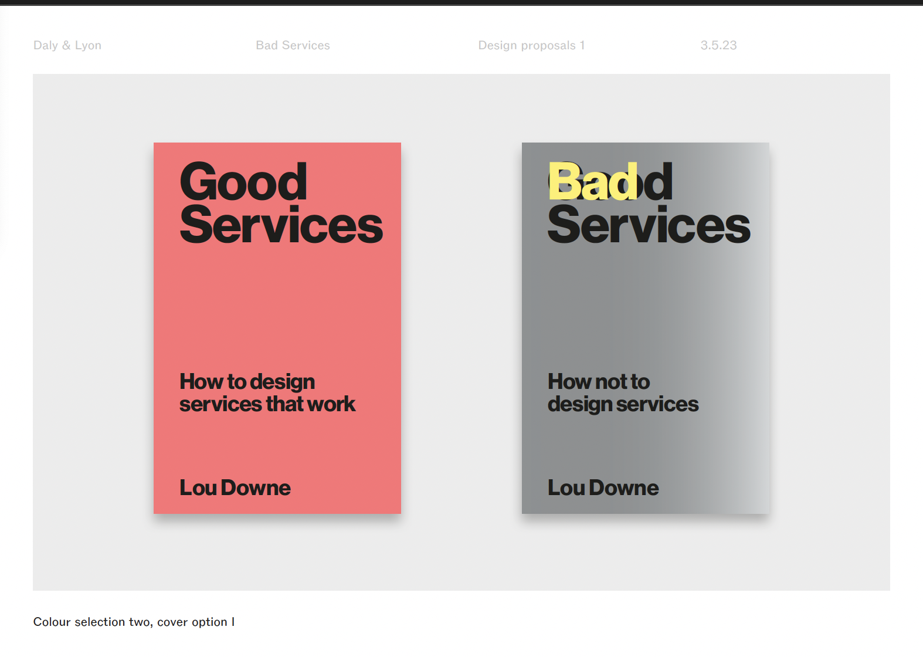

Slide 188
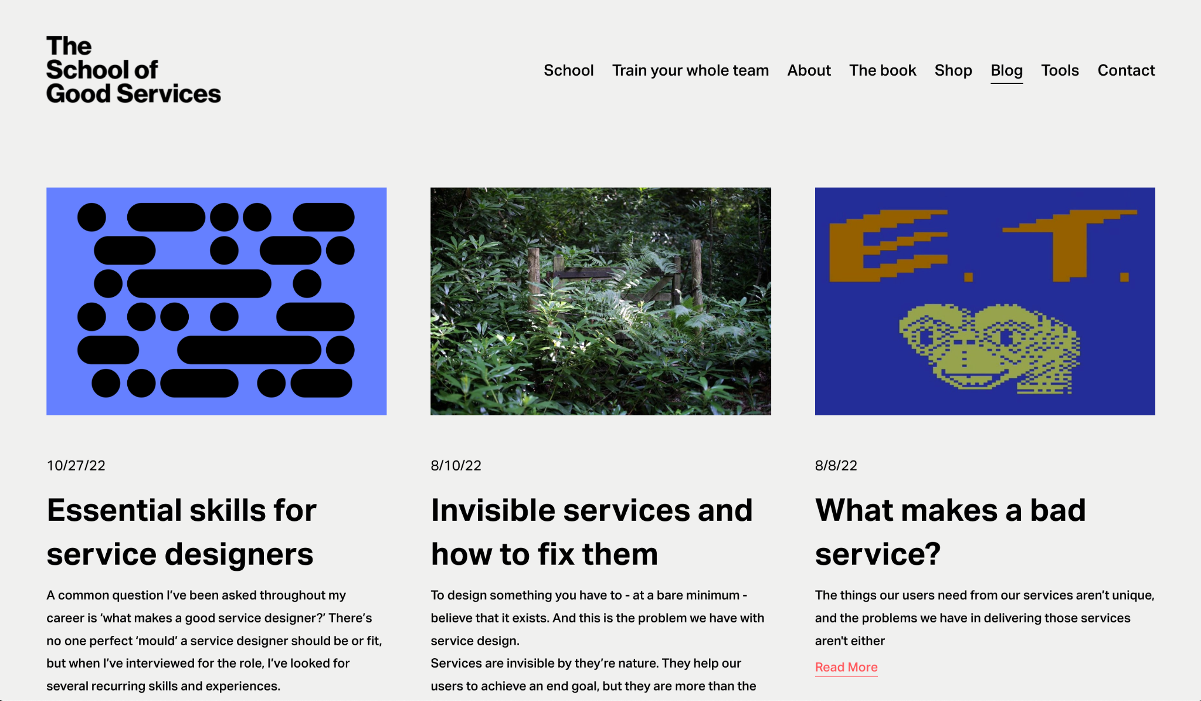

Slide 189
www.good.services

Slide 190
Thanks!

Slide 191
Thanks!
@LouDowne
@TheSchoolofGood
lou@good.services
www.good.services

